Slide 1
Final Exam

Slide 2
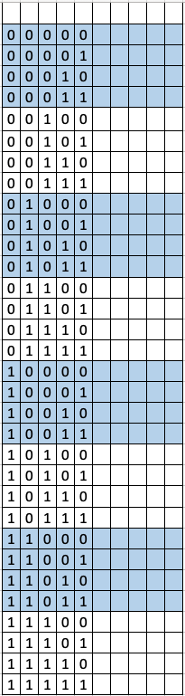
0 | 0 | 0 | 0
0 | 0 | 0 | 1
0 | 0 | 1 | 0
0 | 0 | 1 | 1
0 | 1 | 0 | 0
0 | 1 | 0 | 1
0 | 1 | 1 | 0
0 | 1 | 1 | 1
1 | 0 | 0 | 0
1 | 0 | 0 | 1
1 | 0 | 1 | 0
1 | 0 | 1 | 1
1 | 1 | 0 | 0
1 | 1 | 0 | 1
1 | 1 | 1 | 0
1 | 1 | 1 | 1
0 | 0 | 0
0 | 0 | 1
0 | 1 | 0
0 | 1 | 1
1 | 0 | 0
1 | 0 | 1
1 | 1 | 0
1 | 1 | 1
0 | 0
0 | 1
1 | 0
1 | 1
0 | 0 | 0
0 | 0 | 1
0 | 1 | 0
0 | 1 | 1
1 | 0 | 0
1 | 0 | 1
1 | 1 | 0
1 | 1 | 1
0 | 0 | 0 | 0
0 | 0 | 0 | 1
0 | 0 | 1 | 0
0 | 0 | 1 | 1
0 | 1 | 0 | 0
0 | 1 | 0 | 1
0 | 1 | 1 | 0
0 | 1 | 1 | 1
1 | 0 | 0 | 0
1 | 0 | 0 | 1
1 | 0 | 1 | 0
1 | 0 | 1 | 1
1 | 1 | 0 | 0
1 | 1 | 0 | 1
1 | 1 | 1 | 0
1 | 1 | 1 | 1
 | 0 | 1
00
01
11
10
 | 00 | 01 | 11 | 10
00
01
11
10
A
AB
BC
CD

Slide 3
SerIn
0
1
D Q
0
1
D Q
DIn
0
1
D Q
LOAD/SHIFT#
SerIn
0
1
D Q
0
1
D Q
0
1
D Q
DIn
Q₀
Q₁
Q₂
LOAD
CLK
T_{Setup} = 2 ns, T_{Hold} = 1 ns, T_{clock-Q} = 3 ns,
T_{Not} = 1 ns, T_{NOR2} = 3 ns, T_{AND2} = 2 ns,
T_{2-1MUX} = 4 ns

Slide 4
W’X’
(X’+Y)’
A
W
X’
X’Y’
H
B
X
(X+Y’)’
YZ
XY
XY’
Y’Z’
(X+Y)’
X’
G
C
(YZ)’
XY
Y’
(X+Y)’
F
X’Y
D
(X’+Y)’
Y
X
X’Y
E
X
X’Y’
A, G are complete but with conflict
C, D are incomplete and with conflict
B, E are incomplete but have no conflict
F, H are complete and have no conflict

Slide 5
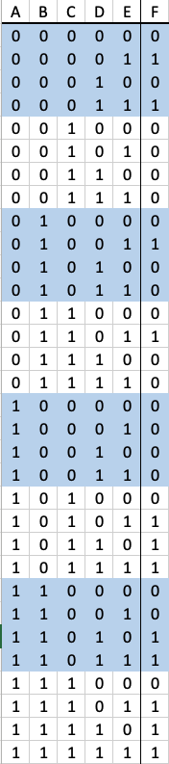
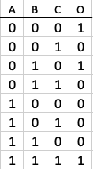
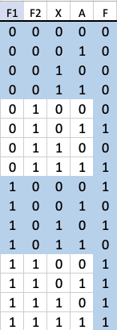
A
3-LUT
B
1
C
_{O}
B
C
D
2
3
F
E
A

Slide 6
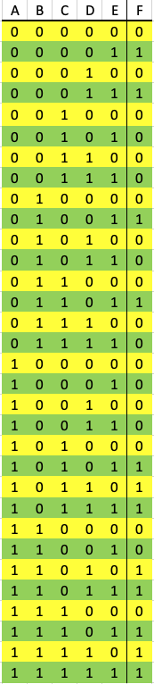
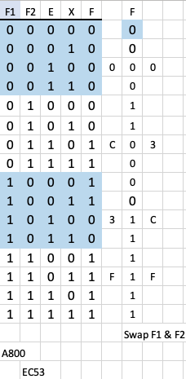
1
A
B
C
2
3
F
D
E

Slide 7
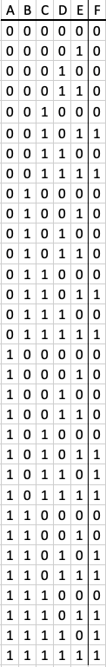
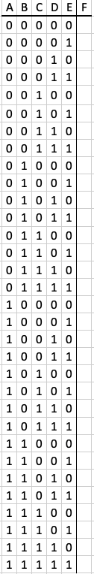
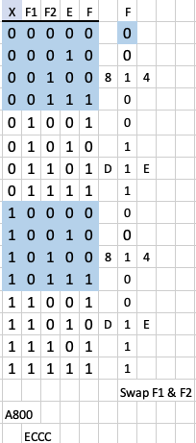
F = ABD + ACD + CE
1
A
B
C
2
3
F
D
E

Slide 8
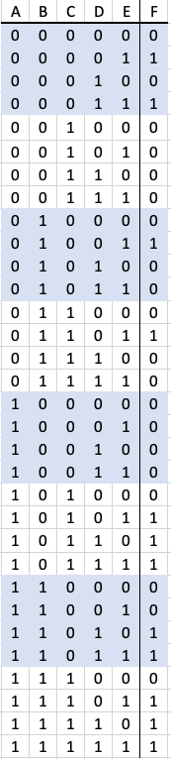
1
A
B
C
2
3
F
D
E

Slide 9
A
B
4LUT
D Q
0
1
Out
always_ff @(posedge Clock)
begin
Out <= E|(~B&~C)|(~B&~D) |(B&D);
end
assign Z = A;
C
D
E
clk
16
0
1
MUX 1
Z
LUT
EEBF
MUX 2
always_ff @(posedge Clock)
begin
Out <= ~D|(~B&C)|(~B&~E) |(B&E);
end
assign Z = A;
always_ff @(posedge Clock)
begin
Out <= ~E|(~B&~C)|(~B&~D) |(B&D);
end
assign Z = A;\\\\\\\\\\
BBF7
DD7F

Slide 10
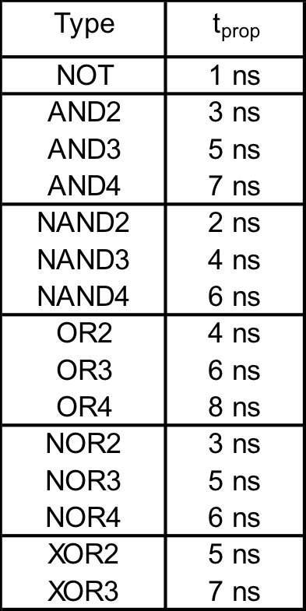
A
B
C
D
E
A
B
C
D
E
F
F
4 3-LUT
3 4-LUT
Critical Path: 3 + 3 + 6 = 12
Cycle Time: 12 + Setup + Clock-to-Q
Frequency: 1/T
A
B
C
D
E
F
F=(B+C)’A+((B+C)’D’)’+DE’+D’E
=AB’C’+(B’C’D’)’+DE’+D’E
=AB’C’+B+C+D+DE’+D’E = AB’C’+B+C+D+D’E
= AB’C’+B+C+(D+D’)(D+E)= AB’C’+B+C+D+E=AB’+B+C+D+E=A+B+C+D+E

Slide 11
A
B
C
D
E
A
B
C
D
E
F
F
A
B
C
D
E
4 3-LUT
3 4-LUT
1 5-LUT
Critical Path: 1 + 3 + 3 + 6 = 13
Cycle Time: 13 + Setup + Clock-to-Q
Frequency: 1/T
F
F=(B+C’)’A+((B+C’)’D)’+DE’+D’E
=AB’C+(B’CD)’+DE’+D’E
=AB’C+B+C’+D’+DE’+D’E = AB’C+B+C’+D’+DE’
= AB’C+B+C’+(D+D’)(D’+E’)= AB’C+B+C’+D’+E’=AB’+B+C’+D’+E’=A+B+C’+D’+E’
A
B
C
D
E
F

Slide 12
Type | t_{prop}
NOT | 1 ns
AND2 AND3 AND4 | 2 ns 3 ns 4 ns
NAND2 NAND3 NAND4 | 1 ns 2 ns 3 ns
OR2 OR3 OR4 | 2 ns 3 ns 4 ns
NOR2 NOR3 NOR4 | 1 ns 2 ns 3 ns
XOR2 XOR3 | 5 ns 7 ns
A
A
B
B
C
F
C
F
D
D
E
E
4 3-LUT
3 4-LUT
Critical Path: 2 + 5 + 3 = 10
Cycle Time: 10 + Setup + Clock-to-Q
Frequency: 1/T
A
B
C
F
D
E
F=(AB)’+(B(C+D))’+(C+D)E’+(C+D)’E
=A’+B’+B’+C’D’+CE’+DE’+C’D’E
= A’+B’+C’D’+CE’+DE’+C’D’E
= A’+B’+C’D’+CE’+DE’
=A’+B’+C’D’+E’

Slide 13
F=m(0,1,2,3,4,5,6,10,11,12,13,14)
 | 00 | 01 | 11 | 10
00 | 1 | 1 | 1 | 0
01 | 1 | 1 | 1 | 0
11 | 1 | 0 | 0 | 1
10 | 1 | 1 | 1 | 1
AB
7 Prime Implicants
2 Essential Prime Implicants
CD
+

Slide 14
F=m(0,1,2,4,5,6,8,9,10,11,14,15)
 | 00 | 01 | 11 | 10
00 | 1 | 1 | 0 | 1
01 | 1 | 1 | 0 | 1
11 | 0 | 0 | 1 | 1
10 | 1 | 1 | 1 | 1
7 Prime Implicants
2 Essential Prime Implicants
AB
CD
+

Slide 15
F=m(0,1,2,3,4,5,6,8,9,10,11,14)
F’=ABC’+BCD
F=(A’+B’+C)(B’+C’+D’)
F’=AC’D+A’CD
F=(A’+C+D’)(A+C’+D’)
F=A’D’+A’C’D+AC+B’D’+BD’
 | 00 | 01 | 11 | 10
00 | 1 | 1 | 0 | 1
01 | 1 | 1 | 0 | 1
11 | 1 | 0 | 0 | 1
10 | 1 | 1 | 1 | 1
AB
 | 00 | 01 | 11 | 10
00 | 1 | 1 | 1 | 1
01 | 1 | 1 | 0 | 0
11 | 0 | 0 | 1 | 1
10 | 1 | 1 | 1 | 1
CD
AB
CD
F=D’+AC+A’C’

Slide 16
F=m(0,1,2,3,4,5,6,9,10,11,13,14)
F’=AC’D’+BCD
F=(A’+C+D)(B’+C’+D’)
F’=BC’D’+BCD
F=(B’+C+D)(B’+C’+D’)
F=A’B’+BC’D+CD’+B’C’+B’D
 | 00 | 01 | 11 | 10
00 | 1 | 1 | 0 | 0
01 | 1 | 1 | 1 | 1
11 | 1 | 0 | 0 | 1
10 | 1 | 1 | 1 | 1
AB
 | 00 | 01 | 11 | 10
00 | 1 | 0 | 0 | 1
01 | 1 | 1 | 1 | 1
11 | 1 | 0 | 0 | 1
10 | 1 | 1 | 1 | 1
CD
AB
CD
F=B’+C’D+CD’

Slide 17
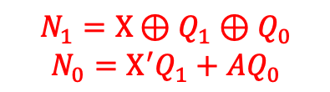
A’
module fsm (
input wire logic Clock, Reset, A,
output logic [1:0] Q,
output logic Z
);
always_ff @(posedge Clock)
if (Reset)
Q <= 2’b00;
else
begin
Q[1] <= A^Q[1]^Q[0];
Q[0] <= ~A&Q[1]|A&Q[0];
end
assign Z = ~Q[1]&Q[0];
endmodule
00
A
A
A
A
11
A’
01
A’
A’
Z
10
A | Q1 | Q0 | N1 | N0
0 | 0 | 0 | 0 | 0
0 | 0 | 1 | 1 | 0
0 | 1 | 0 | 1 | 1
0 | 1 | 1 | 0 | 1
1 | 0 | 0 | 1 | 0
1 | 0 | 1 | 0 | 1
1 | 1 | 0 | 0 | 0
1 | 1 | 1 | 1 | 1
T_{CLK-Q}= 2 ns, T_{hold}= 1 ns, T_{setup}= 2 ns, T_{NOT}= 1 ns, T_{AND2}= 2 ns, T_{OR2}= 3 ns, , T_{XOR3}= 8 ns
$$N_{1}=X⊕Q_{1}⊕Q_{0}$$
$$N_{0}=X^{′}Q_{1}+AQ_{0}$$

Slide 18
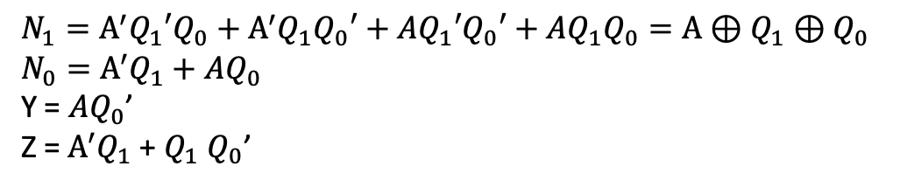
A’
Type | t_{prop}
NOT | 1 ns
AND2 AND3 AND4 | 2 ns 3 ns 4 ns
NAND2 NAND3 NAND4 | 1 ns 2 ns 3 ns
OR2 OR3 OR4 | 2 ns 3 ns 5 ns
NOR2 NOR3 NOR4 | 1 ns 2 ns 3 ns
XOR2 XOR3 | 5 ns 9 ns
00
A | Q₁ | Q₀ | N₁ | N₀ | Y | Z
0 | 0 | 0
0 | 0 | 1
0 | 1 | 0
0 | 1 | 1
1 | 0 | 0
1 | 0 | 1
1 | 1 | 0
1 | 1 | 1
A | Q₁ | Q₀ | N₁ | N₀ | Y | Z
0 | 0 | 0 | 0 | 0 | 0 | 0
0 | 0 | 1 | 1 | 0 | 0 | 0
0 | 1 | 0 | 1 | 1 | 0 | 1
0 | 1 | 1 | 0 | 1 | 0 | 1
1 | 0 | 0 | 1 | 0 | 1 | 0
1 | 0 | 1 | 0 | 1 | 0 | 0
1 | 1 | 0 | 0 | 0 | 1 | 1
1 | 1 | 1 | 1 | 1 | 0 | 0
A
A/Y
A/Y
A
11
A’/Z
01
A’
A’
Z
10
$$N_{1}=A^{′}Q_{1}{′Q}_{0}+A^{′}Q_{1}Q_{0}′+AQ_{1}{′Q}_{0}′+AQ_{1}Q_{0}=A⊕Q_{1}⊕Q_{0}$$
$$N_{0}=A^{′}Q_{1}+AQ_{0}$$
Y = $AQ_{0}$’
Z = $A^{′}Q_{1}$ + $Q_{1}$ $Q_{0}$’
9+2+2=13
5+2+2=10
3+2=5
5+2=7
T_{Setup} = 2 ns, T_{Hold} = 1 ns, T_{Clock-to-Q} = 2 ns.

Slide 19
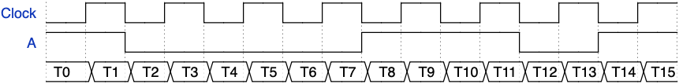
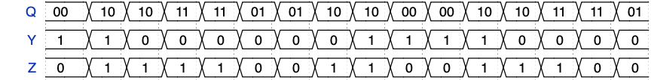
A’
00
A
A/Y
A/Y
A
11
A’/Z
01
A’
A’
Z
10
Notes:
{signal: [
{name: "Clock", wave: "lhlhlhlhlhlhlhlh"},
{name: "A", wave: "h.l.....h...l.h."},
{name: "", wave: "================", data:["T0","T1","T2","T3","T4","T5","T6","T7","T8","T9","T10","T11","T12","T13","T14","T15"]},
{},
{name: "Q", wave: "================", data:["00","10","10","11","11","01","01","10","10","00","00","10","10","11","11","01"]},
{name: "Y", wave: "================", data:["1","1","0","0","0","0","0","0","1","1","1","1","0","0","0","0"]},
{name: "Z", wave: "================", data:["0","1","1","1","1","0","0","1","1","0","0","1","1","1","0","0"]},
]}

Slide 20
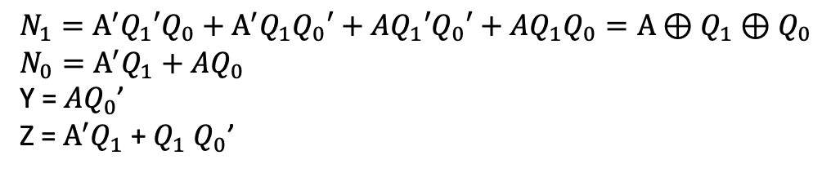
A’
00
A
A/Y
A/Y
A
11
A’/Z
01
A’
A’
Z
10
Clock
A
10
T0
T1
T2
T3
T4
11
01
01
00
10
$$N_{1}=A^{′}Q_{1}{′Q}_{0}+A^{′}Q_{1}Q_{0}′+AQ_{1}{′Q}_{0}′+AQ_{1}Q_{0}=A⊕Q_{1}⊕Q_{0}$$
$$N_{0}=A^{′}Q_{1}+AQ_{0}$$
Y = $AQ_{0}$’
Z = $A^{′}Q_{1}$ + $Q_{1}$ $Q_{0}$’
9+2+2=13
5+2+2=10
3+2=5
5+2=7
8ns before the clock edge
Latches on 00
T_{Setup} = 2 ns, T_{Hold} = 1 ns, T_{Clock-to-Q} = 2 ns.

Slide 21
always_comb
begin
ns = ERR;
Y = 0;
Z = 0;
if (reset)
ns = s0;
else
case (cs)
S0: if (A == 1’b0) ns = S0;
else begin
Y = 1;
ns = S2;
end
S1: if (A == 1’b0) ns = S2;
else ns = S1;
S2: begin
Z = 1;
if (A == 1’b0) ns = S3;
else begin
Y = 1;
ns = S0;
end
end
S3: if (A == 1’b0) begin
Z = 1;
ns = S1;
end
else ns = S3;
endcase
end
always_comb
begin
ns = ERR;
Y = 0;
Z = 0;
if (reset)
ns = s0;
else
case (cs)
S0: if (A == 1’b0) ns = S0;
else begin
Y = 1;
ns = S2;
end
S1: if (A == 1’b0) ns = S2;
else ns = S1;
S2:
S3:
endcase
end
A’
S0
A
A/Y
A/Y
A
S3
A’/Z
S1
A’
A’
Z
S2

Slide 22
begin
Z = 1;
if (A == 1’b0) ns = S3;
else begin
Y = 1;
ns = S0;
end
end
A. begin
Y=1;
if (A == 1’b0) ns=S3;
else begin
Z=1;
ns=S0;
end
end
E. begin
Z=1;
if (A == 1’b0) ns=S3;
else begin
Y=1;
ns=S0;
end
end
B. begin
Z=1;
if (A == 1’b0) ns=S3;
else
Y=1;
ns=S0;
end
F. begin
if (A == 1’b0) begin
Z=1;
ns=S3;
end
else begin
Y=1;
ns=S0;
end
end
C. begin
Z=1;
if (A == 1’b1) ns=S3;
else begin
Y=1;
ns=S0;
end
end
G. begin
Z=1;
if (A == 1’b1) begin
Y=1;
ns=S0;
end
else ns=S3;
end
D. begin
Z=1;
if (A == 1’b0) ns=S3;
else
ns=S0;
Y=1;
end
H. begin
if (A == 1’b1) begin
Y=1;
ns=S0;
end
else begin
Z=1;
ns=S3;
end
end

Slide 23
assign Q[3] = ^(A^B);
assign Q[2] = ((A|B)!=1 &&(B^4’b1011)!=1)? 1’b1:1’b0;
assign Q[1] = (B>(A<<1))?1’b0:1’b1;
assign Q[0] = &({2{2'b01}}|A&B);
A=0101 B=1010
assign Q[3] = ^(0101^1010)=^(1111)=0;
assign Q[2] = (1111!=1 &&(1010^4’b1011)!=1)? 1’b1:1’b0;
assign Q[1] = (b>(a<<1))? 1’b0:1’b1;
assign Q[0] = &({2{2'b01}}|a&b)=0;

Slide 24
assign Q[2] = ((A|B)!=1 &&(B^4’b1011)!=1)? 1’b1:1’b0;
assign Q[1] = (B > (A<<1))? 1’b1 : 1’b0;
assign Q[0] = ({2{2'b01}} > A)? 1’b1 : 1’b0;
A=0101 B=1010
assign Q[2] = (1111!=1 &&(1010^4’b1011)!=1)? 1’b1:1’b0;
assign Q[1] = (b > (a<<1))? 1’b1:1’b0;
assign Q[0] = ({2{2'b01}} >= A)? 1’b1 : 1’b0;

Slide 25
Q2
Q1’
D Q
Q2
Q1’
Q0
clk
Q2
D Q
Q1
Q2’
clk
Q0’
D Q
Q0
Q1
Q0
clk
Q2’
Reset
Q1
100-011-000-100….

Slide 26
x’
Y=XQ1 + Q1Q0’
N1= X’Q1 + XQ0
N0= X’Q0 + XQ1’
X | Q1 | Q0 | N1 | N0 | Y
0 | 0 | 0 | 1 | 1 | 0
0 | 0 | 1 | 1 | 0 | 0
0 | 1 | 0 | 0 | 1 | 1
0 | 1 | 1 | 0 | 0 | 0
1 | 0 | 0 | 1 | 0 | 0
1 | 0 | 1 | 0 | 0 | 0
1 | 1 | 0 | 1 | 1 | 1
1 | 1 | 1 | 0 | 1 | 1
00
x
x
x’
x’
10
Y
01
Y=XQ1 + Q1Q0’
N1= X’Q1’ + XQ0’
N0= X’Q0’ + XQ1
x / Y
x
11
x’
00
x’
x
x’
x
11
01
x / Y
x
x’
x’
10
Y

Slide 27
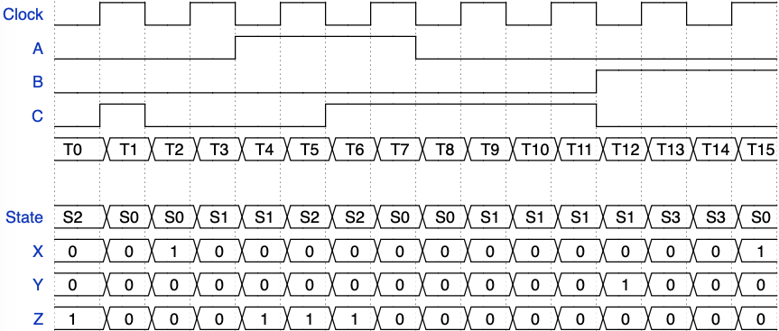
A’B’ + AB
always_comb
begin
ns = ERR;
X = 0;
Y = 0;
Z = 0;
if (reset)
ns = s0;
else
case (cs)
S0: begin
ns = S1;
if (C==0) X = 1;
end
S1: if (A==0 && B=1) begin
Y = 1;
ns = S3;
end
else if (A==1 && B=0) begin
Z = 1;
ns = S2;
end
else ns = S1;
S2: begin
Z = 1;
ns = S0
end
S3: ns = S0;
endcase
end
S1
AB’ / Z
A’B / Y
Z
S2
C
C’ / X
S3
S0

Slide 28
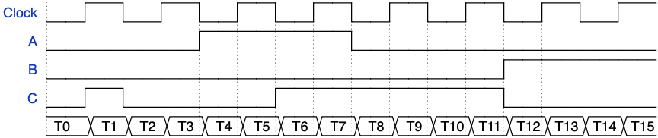
always_comb
begin
ns = ERR;
X = 0;
Y = 0;
Z = 0;
if (reset)
ns = s0;
else
case (cs)
S0: begin
ns = S1;
if (C==0) X = 1;
end
S1: if (A==0 && B=1) begin
Y = 1;
ns = S3;
end
else if (A==1 && B=0) begin
Z = 1;
ns = S2;
end
else ns = S1;
S2: begin
Z = 1;
ns = S0
end
S3: ns = S0;
endcase
end
Notes:
{signal: [
{name: "Clock", wave: "lhlhlhlhlhlhlhlh"},
{name: "A", wave: "l...h...l......."},
{name: "B", wave: "l...........h..."},
{name: "C", wave: "lhl...h.....l..."},
{name: "", wave: "================", data:["T0","T1","T2","T3","T4","T5","T6","T7","T8","T9","T10","T11","T12","T13","T14","T15"]},
{},
{name: "State", wave: "================", data:["S2","S0","S0","S1","S1","S2","S2","S0","S0","S1","S1","S1","S1","S3","S3","S0"]},
{name: "X", wave: "================", data:["0","0","1","0","0","0","0","0","0","0","0","0","0","0","0","1"]},
{name: "Y", wave: "================", data:["0","0","0","0","0","0","0","0","0","0","0","0","1","0","0","0"]},
{name: "Z", wave: "================", data:["1","0","0","0","1","1","1","0","0","0","0","0","0","0","0","0"]},
]}

Slide 29
AB
 | 00 | 01 | 11 | 10
00 | 1 | 0 | 0 | 1
01 | 0 | 1 | 1 | 0
11 | 0 | 1 | 1 | 0
10 | X | X | X | X
_{Q1Q0}
A | B | Q₁ | Q₀ | N₁ | N₀ | Z
0 | 0 | 0 | 0
0 | 0 | 0 | 1
0 | 0 | 1 | 0
0 | 0 | 1 | 1
0 | 1 | 0 | 0
0 | 1 | 0 | 1
0 | 1 | 1 | 0
0 | 1 | 1 | 1
1 | 0 | 0 | 0
1 | 0 | 0 | 1
1 | 0 | 1 | 0
1 | 0 | 1 | 1
1 | 1 | 0 | 0
1 | 1 | 0 | 1
1 | 1 | 1 | 0
1 | 1 | 1 | 1
A | B | Q₁ | Q₀ | N₁ | N₀ | Z
0 | 0 | 0 | 0 | 1 | 1 | 1
0 | 0 | 0 | 1 | 0 | 0 | 1
0 | 0 | 1 | 0 | X | X | X
0 | 0 | 1 | 1 | 0 | 0 | 1
0 | 1 | 0 | 0 | 0 | 0 | 1
0 | 1 | 0 | 1 | 1 | 1 | 0
0 | 1 | 1 | 0 | X | X | X
0 | 1 | 1 | 1 | 1 | 1 | 0
1 | 0 | 0 | 0 | 1 | 1 | 1
1 | 0 | 0 | 1 | 0 | 1 | 1
1 | 0 | 1 | 0 | X | X | X
1 | 0 | 1 | 1 | 0 | 1 | 1
1 | 1 | 0 | 0 | 0 | 1 | 1
1 | 1 | 0 | 1 | 1 | 1 | 0
1 | 1 | 1 | 0 | X | X | X
1 | 1 | 1 | 1 | 1 | 1 | 0
A’B
Z
00
A’B’/Z
AB
AB
 | 00 | 01 | 11 | 10
00 | 1 | 0 | 1 | 1
01 | 0 | 1 | 1 | 1
11 | 0 | 1 | 1 | 1
10 | X | X | X | X
B’
_{Q1Q0}
B
A’B’/Z
AB’/Z
11
01
AB’/Z
B
AB
 | 00 | 01 | 11 | 10
00 | 1 | 1 | 1 | 1
01 | 1 | 0 | 0 | 1
11 | 1 | 0 | 0 | 1
10 | X | X | X | X
_{Q1Q0}
N1=BQ₀+B’Q₀’ or (B’+Q₀)(B+Q₀’)
N2=A+BQ₀+B’Q₀’ or (A+B+Q₀’)(A+B’+Q₀)
Z=B’+Q₀’

Slide 30
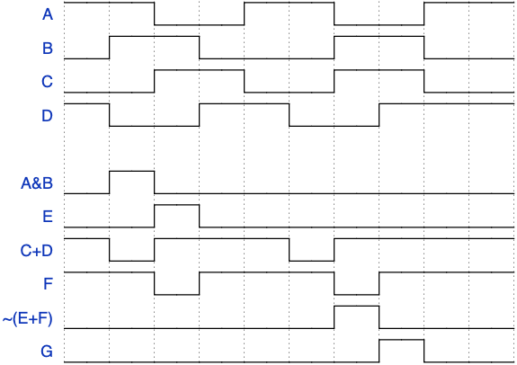
W21
A
E
B
G
C
D
F
9 8 7 6 5 4 3 2 1 0
{signal: [
{name: "A", wave: "h.l.h.l.h." },
{name: "B", wave: "lh.l..h.l." },
{name: "C", wave: "l.h.l.h.l." },
{name: "D", wave: "hl.h.l.h.." },
{},
{name: "A&B", wave: "lhl......." },
{name: "E", wave: "l.hl......" },
{name: "C+D", wave: "hlh..lh..." },
{name: "F", wave: "h.lh..lh.." },
{name: "~(E+F)", wave: "l.....hl.." },
{name: "G", wave: "l......hl." },
]}
Notes:
Timing Analysis – study TANLYS Slide#12

Slide 31
assign E = ~A^~B;
assign F = A&B|~A&~B;
assign G = A^B;
assign H = ~(A|~B);
assign I = ~(A&B);
assign J = ~A&~B;
assign K = A&~B|~A&B;
assign G = ~(A^~B);
assign E = ~(~A^~B);
assign F = A&B|~A&~B;
assign G = A^~B;
assign H = ~(A|~B);
assign I = ~(A^B);
assign J = ~A&~B;
assign K = A&~B|~A&B;
assign G = A&B|~A&~B

Slide 32
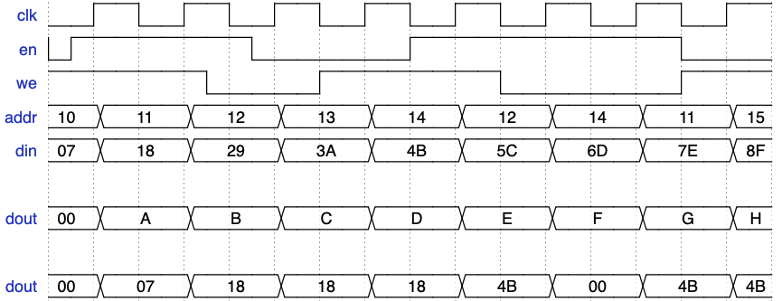
{signal: [
{name: "clk", wave: "lhlhlhlhlhlhlhlh"},
{name: "en", wave: "nh..pl..h.....l." },
{name: "we", wave: "h..pl.h...l...h." },
{name: "addr", wave: "==.=.=.=.=.=.=.=", data:["10","11","12","13","14","12","14","11","15"] },
{name: "din", wave: "==.=.=.=.=.=.=.=", data:["07","18","29","3A","4B","5C","6D","7E","8F"] },
{},
{name: "dout", wave: "==.=.=.=.=.=.=.=", data:["00","A","B","C","D","E","F","G","H"] },
{},
{name: "dout", wave: "==.=.=.=.=.=.=.=", data:["00","07","18","18","18","4B","00","4B","4B"] },
]}
module myram(
input logic clk, we, en,
input logic[7:0] addr,
input logic[7:0] din,
output logic[7:0] dout
);
logic[7:0] ram[256];
always_ff @(posedge clk)
if (en)
if (we)
begin
ram[addr] <= din;
dout <= din;
end
else
dout <= ram[addr];
endmodule

Slide 33
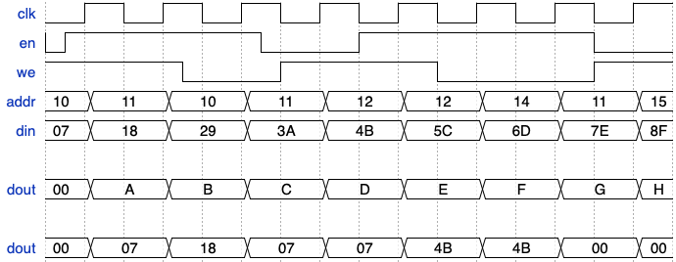
{signal: [
{name: "clk", wave: "lhlhlhlhlhlhlhlh"},
{name: "en", wave: "nh...pl.h.....l." },
{name: "we", wave: "h..pl.h...l...h." },
{name: "addr", wave: "==.=.=.=.=.=.=.=", data:["10","11","10","11","12","12","14","11","15"] },
{name: "din", wave: "==.=.=.=.=.=.=.=", data:["07","18","29","3A","4B","5C","6D","7E","8F"] },
{},
{name: "dout", wave: "==.=.=.=.=.=.=.=", data:["00","A","B","C","D","E","F","G","H"] },
{},
{name: "dout", wave: "==.=.=.=.=.=.=.=", data:["00","07","18","07","07","4B","4B","00","00"] },
]}
module myram(
input logic clk, we, en,
input logic[7:0] addr,
input logic[7:0] din,
output logic[7:0] dout
);
logic[7:0] ram[256];
always_ff @(posedge clk)
if (en)
if (we)
begin
ram[addr] <= din;
dout <= din;
end
else
dout <= ram[addr];
endmodule

Slide 34
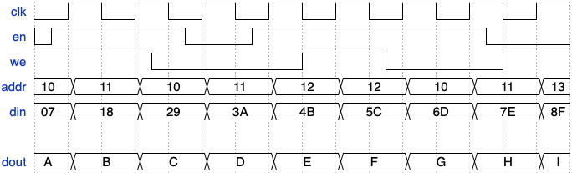
{signal: [
{name: "clk", wave: "lhlhlhlhlhlhlhlh"},
{name: "en", wave: "nh..plnh.....pl." },
{name: "we", wave: "h..pl...h.pl..h." },
{name: "addr", wave: "==.=.=.=.=.=.=.=", data:["10","11","10","11","12","12","10","11","13"] },
{name: "din", wave: "==.=.=.=.=.=.=.=", data:["07","18","29","3A","4B","5C","6D","7E","8F"] },
{},
{name: "dout", wave: "==.=.=.=.=.=.=.=", data:["A","B","C","D","E","F","G","H","I"] },
{},
{name: "dout", wave: "==.=.=.=.=.=.=.=", data:["00","07","18","18","18","4B","4B","07","07"] },
]}
module myram(
input logic clk, we, en,
input logic[7:0] addr,
input logic[7:0] din,
output logic[7:0] dout
);
logic[7:0] ram[256];
always_ff @(posedge clk)
if (en)
if (we)
begin
ram[addr] <= din;
dout <= din;
end
else
dout <= ram[addr];
endmodule

Slide 35
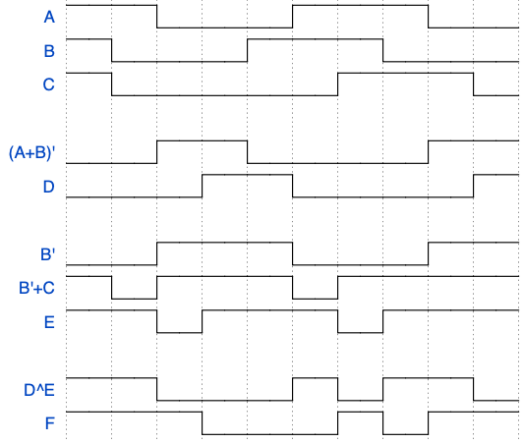
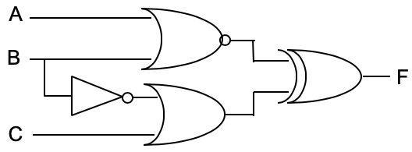
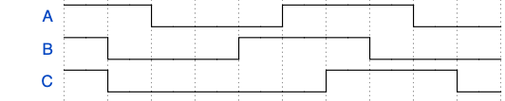
{signal: [
{name: "A", wave: "h.l..h..l." },
{name: "B", wave: "hl..h..l.." },
{name: "C", wave: "hl....h..l"},
{},
{name: "(A+B)'", wave: "l.h.l...h."},
{name: "D", wave: "l..h.l...h"},
{},
{name: "B'", wave: "l.h..l..h."},
{name: "B'+C", wave: "hlh..lh..."},
{name: "E", wave: "h.lh..lh.."},
{},
{name: "D^E", wave: "h.l..hlh.l"},
{name: "F", wave: "h..l..hlh."},
]}
9 | 8 | 7 | 6 | 5 | 4 | 3 | 2 | 1 | 0

Slide 36
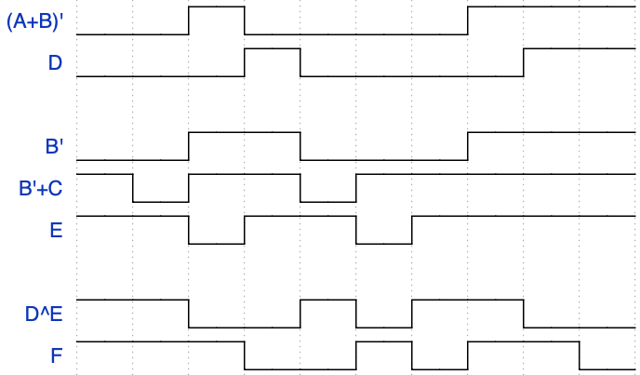
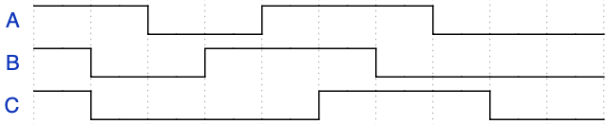
{signal: [
{name: "A", wave: "h.l.h..l.." },
{name: "B", wave: "hl.h..l..." },
{name: "C", wave: "hl...h..l."},
{},
{name: "(A+B)'", wave: "l.hl...h.."},
{name: "D", wave: "l..hl...h."},
{},
{name: "B'", wave: "l.h.l..h.."},
{name: "B'+C", wave: "hlh.lh...."},
{name: "E", wave: "h.lh.lh..."},
{},
{name: "D^E", wave: "h.l.hlh.l."},
{name: "F", wave: "h..l.hlh.l"},
]}
9 | 8 | 7 | 6 | 5 | 4 | 3 | 2 | 1 | 0

Slide 37
Exam 1

Slide 38
A
B
B’
C’
A
A
F
B
B
F
F
C
C
A | B | F
0 | 0
0 | 1
1 | 0
1 | 1
A | B | C | F
0 | 0 | 0
0 | 0 | 1
0 | 1 | 0
0 | 1 | 1
1 | 0 | 0
1 | 0 | 1
1 | 1 | 0
1 | 1 | 1
A | B | C | D | F
0 | 0 | 0 | 0
0 | 0 | 0 | 1
0 | 0 | 1 | 0
0 | 0 | 1 | 1
0 | 1 | 0 | 0
0 | 1 | 0 | 1
0 | 1 | 1 | 0
0 | 1 | 1 | 1
1 | 0 | 0 | 0
1 | 0 | 0 | 1
1 | 0 | 1 | 0
1 | 0 | 1 | 1
1 | 1 | 0 | 0
1 | 1 | 0 | 1
1 | 1 | 1 | 0
1 | 1 | 1 | 1

Slide 39
a
b
c
d
e
f

Slide 40
A.
D.
B.
E.
C.
F.
G.
H.
 |  | A | B | C | D | E | F | G | H
0 | 0 | 0 | 1 | 0 | 0 | 0 | 1 | 0 | 1
0 | 1 | 1 | 1 | 1 | 1 | 1 | 0 | 1 | 0
1 | 0 | 1 | 1 | 1 | 1 | 0 | 0 | 1 | 0
1 | 1 | 0 | 0 | 1 | 0 | 0 | 0 | 0 | 1

Slide 41
A.
D.
B.
E.
C.
F.
G.
H.
 |  | A | B | C | D | E | F | G | H
0 | 0 | 1 | 1 | 1 | 1 | 0 | 1 | 0 | 1
0 | 1 | 0 | 1 | 0 | 0 | 1 | 0 | 1 | 0
1 | 0 | 0 | 1 | 0 | 0 | 0 | 0 | 1 | 0
1 | 1 | 1 | 0 | 1 | 1 | 0 | 0 | 0 | 1

Slide 42
A.
D.
B.
E.
C.
F.
G.
H.
 |  | A | B | C | D | E | F | G | H
0 | 0 | 0 0 | 1 | 0 | 1 | 0 | 1 | 0 0 | 0
0 | 1 | 1 0 | 1 | 1 | 0 | 1 0 | 0 | 0 1 | 1 0
1 | 0 | 0 1 | 1 | 1 | 0 | 0 1 | 0 | 1 0 | 0 1
1 | 1 | 0 0 | 0 | 0 | 1 | 0 | 0 | 1 1 | 0

Slide 43
A.
D.
B.
E.
C.
F.
G.
H.
 |  | A | B | C | D | E | F | G | H
0 | 0 | 1 | 1 | 0 | 1 | 1 | 1 | 1 | 1
0 | 1 | 0 1 | 1 | 1 | 0 | 0 1 | 0 | 0 1 | 1 0
1 | 0 | 1 0 | 1 | 1 | 0 | 1 0 | 0 | 1 0 | 0 1
1 | 1 | 1 | 0 | 0 | 1 | 1 | 0 | 1 | 0

Slide 44
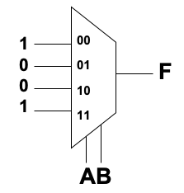
A
B
C
D
A
B
C
D
F
F
1
0
C
C
00
01
10
11
1
B
B’
0
00
01
10
11
C
1
C
0
00
01
10
11
4-to-1
MUX
Z
4-to-1
MUX
Z
4-to-1
MUX
Z
A B
A C
A B

Slide 45
a
b
c
d
and
e
f
g
h
and
and
and
IR[0]
IR[4]
IR[1]
IR[5]
F
and

Slide 46
a
b
c
d
and
e
f
g
h
and
and
and
and
and
and
IR[0]
IR[4]
IR[1]
IR[5]
F

Slide 47
a.
b.
c.
d.
e.
and
f.
g.
h.
I.
j.
and
and
and
and
and
and
IR[0]
IR[4]
IR[1]
IR[5]
F

Slide 48
S
T
U
V
W
X
Y
Z
000
001
010
011
100
101
110
111
I₀
I₁
I₂
I₃
00
01
10
11
F
00
01
10
11
S₂ S₁
F
I₄
I₅
I₆
I₇
00
01
10
11
S
U
W
Y
T
V
X
Z
S₀ S₀
S₂ S₁S₀
S₂ S₁

Slide 49
S
T
U
V
W
X
Y
Z
000
001
010
011
100
101
110
111
I₀
I₁
I₂
I₃
00
01
10
11
F
00
01
10
11
S₂ S₁
F
I₄
I₅
I₆
I₇
00
01
10
11
S
U
W
Y
T
V
X
Z
S₀
S₂ S₁S₀
S₂ S₁

Slide 50
S
T
U
V
W
X
Y
Z
000
001
010
011
100
101
110
111
I₀
I₁
I₂
I₃
00
01
10
11
F
00
01
10
11
S₀ S₁
F
I₄
I₅
I₆
I₇
00
01
10
11
S
U
T
V
W
Y
X
Z
S₂ S₂
S₂ S₁S₀
S₀ S₁

Slide 51
A B C
F
A B C
F

Slide 52
a
b
c
d
and
e
f
g
h
and
and
and
and
and
IR[0]
IR[4]
IR[1]
IR[5]
F
and

Slide 53
a.
b.
c.
d.
e.
f.
Cin
Cout
Cin
Cout
Cin
Cout
Cin
Cout
Cin
Cout
Cin
Cout
I₀
I₁
0
1
I₀
I₁
0
1
W
X
Y
Z
00
01
10
11
F
S₁
0
1
F
S₀
0
1
F
I₂
I₃
0
1
I₂
I₃
0
1
S₁ S₀
S₀
S₁
S₁
S₀

Slide 54
3:8
Decoder
ADD
SUB
AND
XOR
NOT
LOAD
STORE
JUMP
IR[2]
IR[1]
IR[0]
I₂
I₁
I₀
ROM8X4
A | B | C | F | G | H | I
0 | 0 | 0 | 0 | 0 | 0 | 0
0 | 0 | 1 | 0 | 1 | 1 | 0
0 | 1 | 0 | 1 | 0 | 1 | 0
0 | 1 | 1 | 1 | 1 | 1 | 0
1 | 0 | 0 | 0 | 0 | 1 | 1
1 | 0 | 1 | 0 | 1 | 0 | 1
1 | 1 | 0 | 1 | 1 | 0 | 0
1 | 1 | 1 | 1 | 0 | 0 | 1
A
a2
F
G
B
a1
H
C
a0
I

Slide 55
10% | 20% | 30% | 40% | Pass
0 | 0 | 0 | 0 | 0
0 | 0 | 0 | 1 | 0
0 | 0 | 1 | 0 | 0
0 | 0 | 1 | 1 | 1
0 | 1 | 0 | 0 | 0
0 | 1 | 0 | 1 | 1
0 | 1 | 1 | 0 | 0
0 | 1 | 1 | 1 | 1
1 | 0 | 0 | 0 | 0
1 | 0 | 0 | 1 | 1
1 | 0 | 1 | 0 | 0
1 | 0 | 1 | 1 | 1
1 | 1 | 0 | 0 | 0
1 | 1 | 0 | 1 | 1
1 | 1 | 1 | 0 | 1
1 | 1 | 1 | 1 | 1
40% | 30% | 20% | 10% | Pass
0 | 0 | 0 | 0 | 0
0 | 0 | 0 | 1 | 0
0 | 0 | 1 | 0 | 0
0 | 0 | 1 | 1 | 0
0 | 1 | 0 | 0 | 0
0 | 1 | 0 | 1 | 0
0 | 1 | 1 | 0 | 0
0 | 1 | 1 | 1 | 1
1 | 0 | 0 | 0 | 0
1 | 0 | 0 | 1 | 1
1 | 0 | 1 | 0 | 1
1 | 0 | 1 | 1 | 1
1 | 1 | 0 | 0 | 1
1 | 1 | 0 | 1 | 1
1 | 1 | 1 | 0 | 1
1 | 1 | 1 | 1 | 1
EAA8
FE80

Slide 56
Exam 2

Slide 57
Type | t_{prop}
NOT | 1 ns
AND2 AND3 AND4 | 2 ns 3 ns 4 ns
NAND2 NAND3 NAND4 | 1 ns 2 ns 3 ns
OR2 OR3 OR4 | 2 ns 3 ns 4 ns
NOR2 NOR3 NOR4 | 1 ns 2 ns 3 ns
XOR2 XOR3 | 5 ns 7 ns
00
x
X | Q₁ | Q₀ | N₁ | N₀ | Y | Z
0 | 0 | 0
0 | 0 | 1
0 | 1 | 0
0 | 1 | 1
1 | 0 | 0
1 | 0 | 1
1 | 1 | 0
1 | 1 | 1
X | Q₁ | Q₀ | N₁ | N₀ | Y | Z
0 | 0 | 0 | 0 | 1 | 0 | 0
0 | 0 | 1 | 0 | 0 | 0 | 1
0 | 1 | 0 | 1 | 1 | 0 | 0
0 | 1 | 1 | 1 | 0 | 0 | 1
1 | 0 | 0 | 1 | 1 | 0 | 0
1 | 0 | 1 | 1 | 0 | 0 | 1
1 | 1 | 0 | 0 | 1 | 1 | 0
1 | 1 | 1 | 0 | 0 | 1 | 0
x’
Z
01
x’
x/Y
11
x
x’
x/Y
x’/Z
10
N1= X’Q1 + XQ1’
N0= Q0’
Y=XQ1
Z=Q1’Q0+X’Q0
5
1
2
5
5+2+3 = 10
100 MHz
5
8
{signal: [
{name: "Clock", wave: "lhlhlhlhlhlhlhlh"},
{name: "X", wave: "h.l.h.l.h.....l."},
{name: "", wave: "================", data:["T0","T1","T2","T3","T4","T5","T6","T7","T8","T9","T10","T11","T12","T13","T14","T15"]},
{},
{name: "Q", wave: "================", data:["00","11","11","10","10","01","01","00","00","11","11","00","00","11","11","10"]},
{name: "Y", wave: "================", data:["0","1","0","0","1","0","0","0","0","1","1","0","0","1","1","0"]},
{name: "Z", wave: "================", data:["0","0","1","0","0","1","1","0","0","0","0","0","0","0","1","0"]},
]}
T_{Setup} = 2 ns, T_{Hold} = 1 ns, T_{Clock-to-Q} = 3 ns.

Slide 58


00
x’
x
Z
01
x’
x/Y
11
x
x’
x/Y
x’/Z
10

Slide 59
typedef enum {s0,s1,s2,s3,ERR=’X} StateType;
StateType ns, cs;
always_comb
begin
ns = ERR;
Z = 0;
Y = 0;
if (reset)
ns = S0;
else
case (cs)
S0: begin
Z = 1’b1;
if (!A) ns = S1;
else ns = S0;
end
S1: if (A) ns = S2;
else ns = S1;
S2: if (!A) ns = S1;
else begin
ns = S3;
Y = 1’b1;
end
S3: if (A) ns = S0;
else ns = S1;
endcase
end
always_ff @(posedge clk)
cs <= ns;
always_comb
begin
ns = ERR;
Z = 0;
Y = 0;
if (reset)
ns = S0;
else
case (cs)
S0:
S1:
S2:
S3:
endcase
end
always_ff @(posedge clk)
cs <= ns;
00
x’
x
Z
01
x’
x/Y
11
x
x’
x/Y
x’/Z
10

Slide 60
1
q
c
4
4
1
“0011”
4

Slide 61
Always_ff @(posedge clk)
if (clr)
Q <= 0;
else if (inc)
Q <= Q + 1;
A.
B.
C.
Q
00
01
10
11
+1
0
1
+1
0
1
Q+1
4
D Q
Q
0
1
D Q
Q
0
1
D Q
Q
4
Q
4
4
4
4
0000
4
4
0
4
0000
4
inc
clr
inc
clr
2
clk
clk
clr inc
clk
D.
E.
F.
Q
00
01
10
11
0
1
0
1
Q+1
4
D Q
Q
+1
0
1
D Q
Q
+1
0
1
D Q
Q
4
0
4
4
4
4
0000
4
4
0
4
0000
4
clr
inc
clr
inc
2
clk
clk
clr inc
clk
G.
H.
I.
Q
00
01
10
11
0
00
01
10
11
0
00
01
10
11
Q+1
4
D Q
Q
Q
4
D Q
Q
Q
4
D Q
Q
4
4
Q+1
4
0
4
4
0
4
4
4
4
Q+1
4
Q+1
4
Q
4
4
4
4
2
2
2
clk
clr inc
clk
clr inc
clk
clr inc

Slide 62
W21
Always_ff @(posedge clk)
if (inc)
Q <= Q + 1;
else if (clr)
Q <= 0;
A.
B.
C.
Q
00
01
10
11
+1
0
1
+1
0
1
Q+1
4
D Q
Q
0
1
D Q
Q
0
1
D Q
Q
4
Q
4
4
4
4
0000
4
4
0
4
0000
4
inc
clr
inc
clr
2
clk
clk
clr inc
clk
D.
E.
F.
Q
00
01
10
11
0
1
0
1
Q+1
4
D Q
Q
+1
0
1
D Q
Q
+1
0
1
D Q
Q
4
0
4
4
4
4
0000
4
4
0
4
0000
4
clr
inc
clr
inc
2
clk
clk
clr inc
clk
G.
H.
I.
Q
00
01
10
11
0
00
01
10
11
0
00
01
10
11
Q+1
4
D Q
Q
Q
4
D Q
Q
Q
4
D Q
Q
4
4
Q+1
4
0
4
4
0
4
4
4
4
Q+1
4
Q+1
4
Q
4
4
4
4
2
2
2
clk
clr inc
clk
clr inc
clk
clr inc

Slide 63
 |  | A. | always_ff @(posedge clk) if (S₁) if(S₀) Q <= Q >> 1; else Q <= 0; else if (S₀) Q <= Q << 1; | B. | always_ff @(posedge clk) if (S₁) if(S₀) Q <= 0; else Q <= Q >> 1; else if (S₀) Q <= Q << 1;
C. | always_ff @(posedge clk) if (!S₁) begin if(S₀) Q <= Q << 1; end else if (!S₀) Q <= Q >> 1; else Q <= 0; | D. | always_ff @(posedge clk) if (!S₁) if(S₀) Q <= Q << 1; else Q <= 0; else if (!S₀) Q <= Q >> 1; | E. | always_ff @(posedge clk) if (!S₀) begin if(S₁) Q <= Q >> 1; end else if (!S₁) Q <= Q << 1; else Q <= 0;
F. | always_ff @(posedge clk) if (S₀) if(S₁) Q <= Q >> 1; else Q <= 0; else if (S₁) Q <= Q << 1; | G. | always_ff @(posedge clk) if (!S₀) begin if(S₁) Q <= Q >> 1; end else if (S₁) Q <= Q << 1; else Q <= 0; | H. | always_ff @(posedge clk) if (S₀) if(S₁) Q <= 0; else Q <= Q >> 1; else if (S₁) Q <= Q << 1;
Q
00
01
10
11
Q<<1
4
D Q
Q
Q>>1
4
4
4
0
4
4
2
clk
S₁S₀

Slide 64
W21
 |  | A. | always_ff @(posedge clk) if (S₁) if(S₀) Q <= Q >> 1; else Q <= Q + 1; else if (S₀) Q <= Q << 1; | B. | always_ff @(posedge clk) if (S₁) if(S₀) Q <= Q + 1; else Q <= Q >> 1; else if (S₀) Q <= Q << 1;
C. | always_ff @(posedge clk) if (!S₁) begin if(S₀) Q <= Q << 1; end else if (!S₀) Q <= Q + 1; else Q <= Q >> 1; | D. | always_ff @(posedge clk) if (!S₁) begin if(S₀) Q <= Q << 1; end else if (!S₀) Q <= Q >> 1; else Q <= Q + 1; | E. | always_ff @(posedge clk) if (!S₀) begin if(S₁) Q <= Q >> 1; end else if (!S₁) Q <= Q << 1; else Q <= Q + 1;
F. | always_ff @(posedge clk) if (!S₀) begin if(S₁) Q <= Q >> 1; end else if (S₁) Q <= Q << 1; else Q <= Q + 1; | G. | always_ff @(posedge clk) if (S₀) if(S₁) Q <= Q + 1; else Q <= Q << 1; else if (S₁) Q <= Q >> 1; | H. | always_ff @(posedge clk) if (S₀) if(S₁) Q <= Q + 1; else Q <= Q << 1; else if (!S₁) Q <= Q >> 1;
Q
00
01
10
11
Q<<1
4
D Q
Q
Q>>1
4
4
4
Q+1
4
4
2
clk
S₁S₀

Slide 65
000
111
010
Z
101
100
Z
011
110
001
always_ff @(posedge clk)
if (!S₀)
begin
if(S₁) Q <= Q >> 1;
end
else if (S₁)
Q <= Q << 1;
else
Q <= Q + 1;

Slide 66
A
B=1
F
C=1
1+2+4 = 7 ns
2+3+6 = 11 ns - Practice Exam
F
A
B
G
E
E
C
A
D
B
F
2+2+6 =10 ns
E
D
C
Exam 2 Winter 2020 – 1
: 1+5+6 =12 ns
A
B
F
D
C
Exam 2 – 1 a: 2+5+6 =13 ns

Slide 67
F
A
A&B: 2+6= 8 ns
C&D: 4+2+6=12 ns
C&D: 4+5+6=15 ns
E: 5+6 =11 ns
B
G
E
C
D
2+2+6=10 ns
2+2+6=10 ns
5+6 =11 ns
Type | t_{prop}
NOT | 1 ns
AND2 AND3 AND4 | 2 ns 3 ns 4 ns
NAND2 NAND3 NAND4 | 1 ns 2 ns 3 ns
OR2 OR3 OR4 | 2 ns 3 ns 4 ns
NOR2 NOR3 NOR4 | 1 ns 2 ns 3 ns
XOR2 XOR3 | 5 ns 7 ns
A
B
A&B: 1+3= 4 ns
C&D: 2+1+3=6 ns
C&D: 2+5+3=10 ns
E: 5+3 =8 ns
C
F
D
E

Slide 68
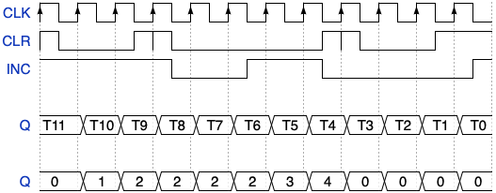
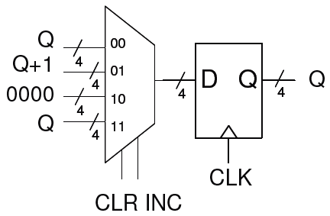
{signal: [
{name: "CLK", wave: "P..........."},
{name: "CLR", wave: "plnpl..nplnh" },
{name: "INC", wave: "h..plnhpl..n" },
{},
{name: "Q", wave: "============", data:["T11","T10","T9","T8","T7","T6","T5","T4","T3","T2","T1","T0"]},
{},
{name: "Q", wave: "============", data:["0","1","2","2","2","2","3","4","0","0","0","0"]},
]}

Slide 69
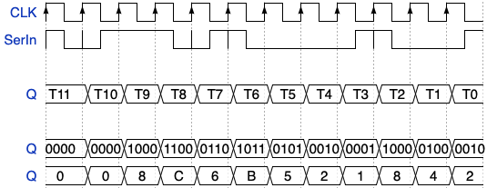
{signal: [
{name: "CLK", wave: "P..........."},
{name: "SerIn", wave: "pnhpnpl.npln" },
{},
{name: "Q", wave: "============", data:["T11","T10","T9","T8","T7","T6","T5","T4","T3","T2","T1","T0"]},
{},
{name: "Q", wave: "============", data:["0000","0000","1000","1100","0110","1011","0101","0010","0001","1000","0100","0010"]},
{name: "Q", wave: "============", data:["0","0","8","C","6","B","5","2","1","8","4","2"]},
]}
Q[3]
Q[2]
Q[1]
Q[0]
SerIn
D Q
D Q
D Q
D Q
CLK

Slide 70
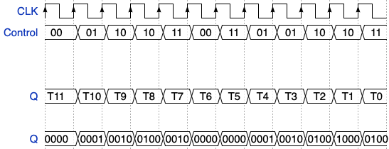
{signal: [
{name: "CLK", wave: "P..........."},
{name: "Control", wave: "============", data:["00","01","10","10","11","00","11","01","01","10","10","11"]},
{}, {},
{name: "Q", wave: "============", data:["T11","T10","T9","T8","T7","T6","T5","T4","T3","T2","T1","T0"]},
{},
{name: "Q", wave: "============", data:["0000","0001","0010","0100","0010","0000","0000","0001","0010","0100","1000","0100"]},
]}
0000
Q+1
4
D Q
Q<<1
4
Q
4
4
Q>>1
4
4
2
Control
CLK

Slide 71
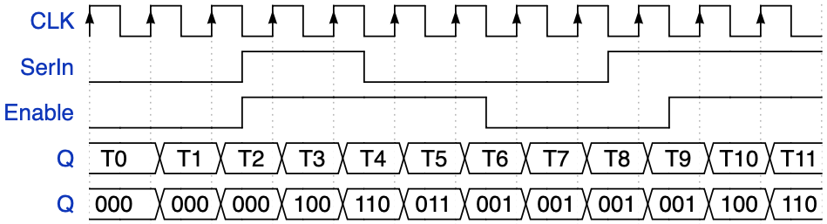
{signal: [
{name: "CLK", wave: "P..........."},
{name: "SerIn", wave: "l.nhpl..nh.."},
{name: "Enable", wave: "l.nh..pl.nh."},
{name: "Q", wave: "============", data:["T0","T1","T2","T3","T4","T5","T6","T7","T8","T9","T10","T11"]},
{name: "Q", wave: "============", data:["000","000","000","100","110","011","001","001","001","001","100","110"]},
]}
0
1
D Q
0
1
D Q
0
1
D Q
SerIn
Q[0]
Q[2]
Q[1]
Enable
CLK

Slide 72
INC’
00
INC
INC
01
CLR • INC’
CLR • INC’
10
CLR’ • INC’
CLR • INC’
CLR’ • INC’
INC
INC
11
CLR’ • INC’

Slide 73
Type | t_{prop}
NOT | 1 ns
AND2 AND3 AND4 | 2 ns 3 ns 4 ns
NAND2 NAND3 NAND4 | 1 ns 2 ns 3 ns
OR2 OR3 OR4 | 2 ns 3 ns 4 ns
NOR2 NOR3 NOR4 | 1 ns 2 ns 3 ns
XOR2 XOR3 | 5 ns 7 ns
00
A
A
A’
Z
01
A’
11
A’
A / Y
A
10
A’
{signal: [
{name: "Clock", wave: "lhlhlhlhlhlhlhlh"},
{name: "A", wave: "h.l.h.l.h.....l."},
{name: "", wave: "================", data:["T0","T1","T2","T3","T4","T5","T6","T7","T8","T9","T10","T11","T12","T13","T14","T15"]},
{},
{name: "Q", wave: "================", data:["00","00","00","11","11","10","10","11","11","10","10","01","01","00","00","11"]},
{name: "Z", wave: "================", data:["1","1","1","0","0","0","0","0","0","0","0","0","0","1","1","0"]},
{name: "Y", wave: "================", data:["0","0","0","0","0","1","0","0","0","1","1","0","0","0","0","0"]},
]}
N1=A’+ Q1Q0
N0=A’+ Q1Q0’
Z=Q1’Q0’
Y=AQ1Q0’
T_{Setup} = 2 ns, T_{Hold} = 1 ns, T_{Clock-to-Q} = 3 ns.
4 ns
5 ns
3 ns
4 ns

Slide 74
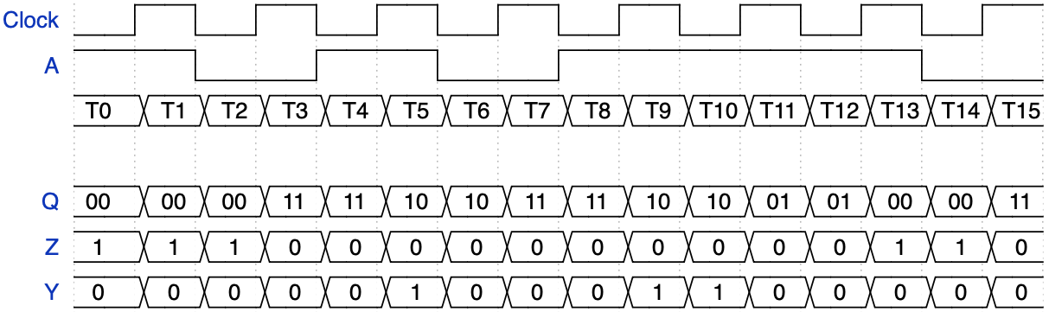
00
A
A
A’
Z
01
A’
11
A’
A / Y
A
10
A’

Slide 75
typedef enum {s0,s1,s2,s3,ERR=’X} StateType;
StateType ns, cs;
always_comb
begin
ns = ERR;
Z = 0;
Y = 0;
if (reset)
ns = S0;
else
case (cs)
S0: begin
Z = 1’b1;
if (!A) ns = S1;
else ns = S0;
end
S1: if (A) ns = S2;
else ns = S1;
S2: if (!A) ns = S1;
else begin
ns = S3;
Y = 1’b1;
end
S3: if (A) ns = S0;
else ns = S1;
endcase
end
always_ff @(posedge clk)
cs <= ns;
always_comb
begin
ns = ERR;
Z = 0;
Y = 0;
if (reset)
ns = S0;
else
case (cs)
S0:
S1:
S2:
S3:
endcase
end
always_ff @(posedge clk)
cs <= ns;
S0
A
A
A’
Z
S3
A’
S1
A’
A / Y
A
S2
A’

Slide 76
S0: if (!A) begin
Z = 1’b1;
ns = S0;
end
else ns = S1;
S0: begin
Z = 1’b1;
if (!A) ns = S0;
else ns = S1;
end
B. S0: if (!A) begin
Z = 1’b1;
ns = S1;
end
else ns = S0;
F. S0: begin
Z = 1’b1;
if (!A) ns = S1;
else ns = S0;
end
C. S0: if (!A) ns = S0;
else begin
ns = S1;
Z = 1’b1;
end
G. S0: Z = 1’b1;
begin
if (!A) ns = S1;
else ns = S0;
end
D. S0: if (!A) ns = S1;
else begin
ns = S0;
Z = 1’b1;
end
H. S0: Z = 1’b1;
begin
if (!A) ns = S1;
else ns = S0;
end
S2: if (!A) begin
Y = 1’b1;
ns = S3;
end
else ns = S1;
S2: begin
Y = 1’b1;
if (!A) ns = S3;
else ns = S1;
end
B. S2: if (!A) begin
Y = 1’b1;
ns = S1;
end
else ns = S3;
F. S2: begin
Y = 1’b1;
if (!A) ns = S1;
else ns = S3;
end
C. S2: if (!A) ns = S3;
else begin
ns = S1;
Y = 1’b1;
end
G. S2: Y = 1’b1;
begin
if (!A) ns = S1;
else ns = S3;
end
D. S2: if (!A) ns = S1;
else begin
ns = S3;
Y = 1’b1;
end
H. S2: Y = 1’b1;
begin
if (!A) ns = S1;
else ns = S3;
end

Slide 77
D
Q
Q’
CLK

Slide 78
Right Camera
Z=0, X=0
Z
Z=0, Y=0
Z
Left Camera
Side View
Y
Top View
X

Slide 79
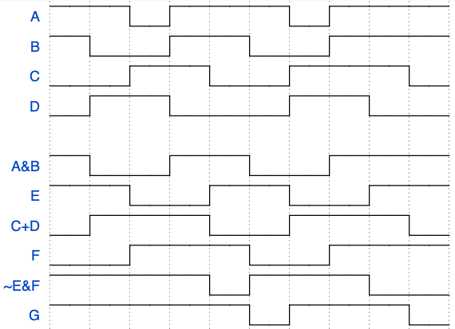
A
E
B
G
C
D
F
9 8 7 6 5 4. 3 2 1 0
{signal: [
{name: "A", wave: "h.lh..lh.." },
{name: "B", wave: "hl.h.l.h.." },
{name: "C", wave: "l.h.l.h..l" },
{name: "D", wave: "lh.l..h.l." },
{},
{name: "A&B", wave: "hl.h.l.h.." },
{name: "E", wave: "h.l.h.l.h." },
{name: "C+D", wave: "lh..l.h..l" },
{name: "F", wave: "l.h..l.h.." },
{name: "~E&F", wave: "h...lh..l." },
{name: "G", wave: "h....lh..l" },
]}
Notes:
Timing Analysis – study TANLYS Slide#12

Slide 80
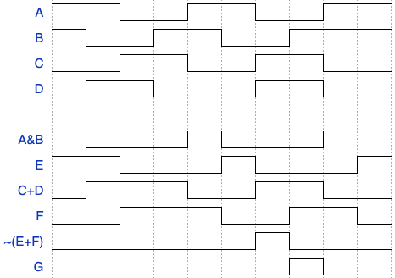
W21 Game 2
A
E
B
G
C
D
F
9 8 7 6 5 4 3 2 1 0
{signal: [
{name: "A", wave: "h.l.h.l.h." },
{name: "B", wave: "hl.h.l.h.." },
{name: "C", wave: "l.h.l.h.l." },
{name: "D", wave: "lh.l..h.l." },
{},
{name: "A&B", wave: "hl..hl..h." },
{name: "E", wave: "h.l..hl..h" },
{name: "C+D", wave: "lh..l.h.l." },
{name: "F", wave: "l.h..l.h.l" },
{name: "~(E+F)", wave: "l.....hl.." },
{name: "G", wave: "l......hl." },
]}
Notes:
Timing Analysis – study TANLYS Slide#12

Slide 81
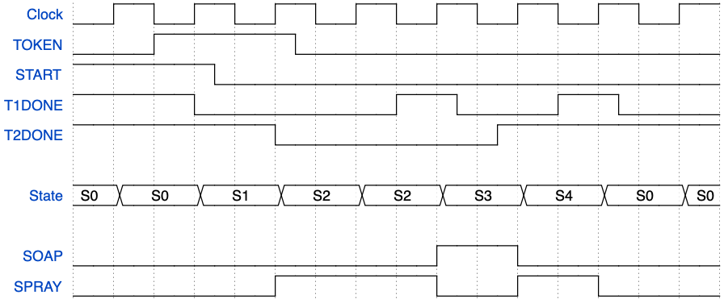
{signal: [
{name: "Clock", wave: "lhlhlhlhlhlhlhlh"},
{name: "TOKEN", wave: "l.h..pl........." },
{name: "START", wave: "h..pl..........." },
{name: "T1DONE", wave: "h..l....hpl.hpl." },
{name: "T2DONE", wave: "h....l....nh...." },
{},
{name: "State", wave: "==.=.=.=.=.=.=.=", data:["S0","S0","S1","S2","S2","S3","S4","S0","S0"] },
{},
{name: "SOAP", wave: "l........h.l...." },
{name: "SPRAY", wave: "l....h...l.h.l.." },
]}
TOKEN’
S0
TOKEN
T1DONE
CLRT1
S1
TOKEN’ • START’
START
TOKEN • START’
S4
T1DONE’
T1DONE’
SPRAY
SPRAY, CLRT2
S2
T2DONE
T1DONE
S3
SOAP, CLRT1
T2DONE’

Slide 82
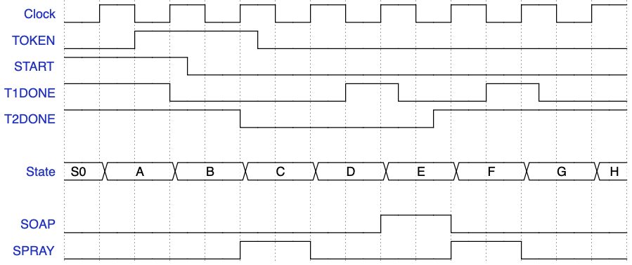
15 | 14 | 13 | 12 | 11 | 10 | 9 | 8 | 7 | 6 | 5 | 4 | 3 | 2 | 1 | 0

Slide 83
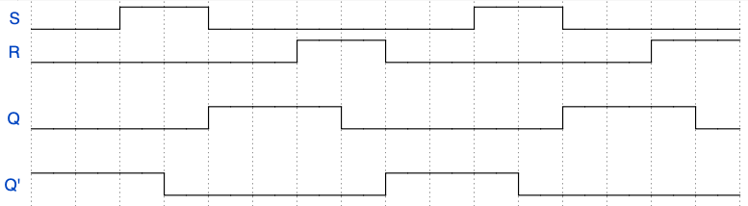
{signal: [
{name: "S", wave: "l.h.l.....h.l..."},
{name: "R", wave: "l.....h.l.....h." },
{},
{name: "Q", wave: "l...h..l....h..l" },
{},
{name: "Q'", wave: "h..l....h..l...." },
{},
]}
R
Q
15 14 13 12 11 10 9 8 7 6 5 4 3 2 1 0
Q’
S

Slide 84
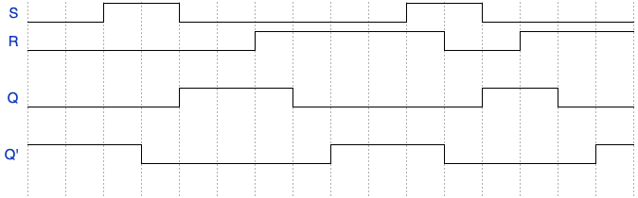
{signal: [
{name: "S", wave: "l.h.l.....h.l..."},
{name: "R", wave: "l.....h....l.h.." },
{},
{name: "Q", wave: "l...h..l....h.l." },
{},
{name: "Q'", wave: "h..l....h..l...h" },
{},
]}
R
Q
15 14 13 12 11 10 9 8 7 6 5 4 3 2 1 0
Q’
S

Slide 85
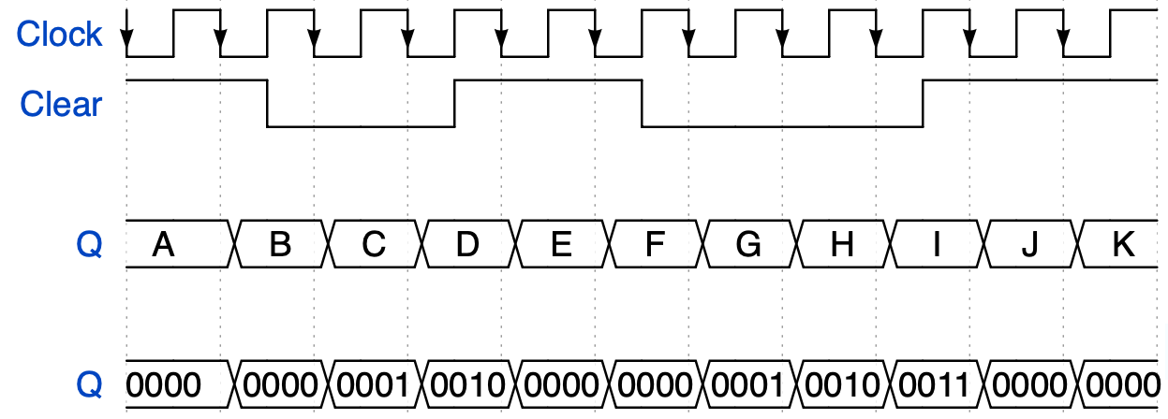
{signal: [
{name: "Clock", wave: "N.........."},
{name: "Clear", wave: "hplnhpl.nh." },
{},
{name: "Q", wave: "===========", data:["A","B","C","D","E","F","G","H","I","J","K"]},
{},
{name: "Q", wave: "===========", data:["0000","0000","0001","0010","0000","0000","0001","0010","0011","0000","0000"]},
]}
module multiAssign (
input wire logic clk, clear,
output logic[3:0] Q
);
always_ff @(negedge clk)
begin
Q <= 4'b0000;
if (!clear)
Q <= Q + 1;
end
endmodule

Slide 86
A
B
C
D
E
F
always_comb
begin
C = ~(A|B);
D = ~B&C;
E = C^D;
end
A=4’b0101
B=4’b0110
C=4’b1000
D=4’b1000
E=4’b0000
A
B
F
C

Slide 87
A
B
C
A=(A’BC+A’B’C’)’=A+B’C+BC’
B=C’
C=A’
000-011-001-101-100-110-110…
Q’
Q
Q’
Q
Q’
Q
D
D
D
CLK
A’
B’
C
CLK
A
0"
B
C
Q’
Q’
Q
Q
Q’
Q’
Q
Q
Q’
Q’
Q
Q
CLK
CLK
CLK
CLK
CLK
D
CLK
D
D
D
D
D
A’ B
C+ = A’+B ABC=000 – 111 - 001
B+ = A’C’ - 101 – 100 – 100 …
A+ = B’

Slide 88
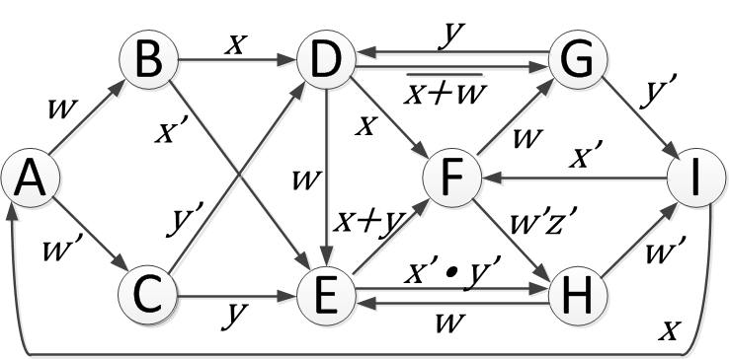
A
w’x’
D
w’x’
A
B
w
(w+x)’
(x+y)’
w
wz
wx
wx
x’y’
A and D have conflict
C is incomplete
C
x
(wz)’
(wx)’
x+y
C
w’z’
(wx)’
x+y
w’z’
(wz)’
x
B
x’y’
E
w
D
E
wz
w
A Complete but with conflict
B Complete but with conflict
C Complete and No Conflict
D Incomplete and Conflict
E Incomplete and No Conflict
D is complete but has a conflict
F has no conflict but is not complete
A, G are complete but have a conflict
B are incomplete but have no conflict
F, H are complete and have no conflict

Slide 89
A
D
w
(w+x)’
w
wx
x
C
(wz)’
(wx)’
x+y
w’z’
B
x’y’
E
wz

Slide 90
sum
sample
+
0
1
D Q
average
24
28
28
Q
28
28
24
(MSB’s)
done
CLK
module myram(
input logic clk,
input logic[9:0] addr,
input logic[23:0] sample,
output logic done,
output logic[23:0] Q
);
reg[3:0] cnt;
reg[27:0] sum;
assign done = &cnt; // done = 1 when cnt = 4’b1111 assign Q = sum[27:4];
always_ff @(posedge clk)
begin
if (done)
sum <= {{4{sample[23]}}, sample};
else
sum <= {{4{sample[23]}}, sample} + sum;
end a
lways_ff @(posedge clk)
cnt <= cnt + 1; // 0~15endmodule
endmodule
+
D Q
4
4
4
cnt
CLK

Slide 91
0
00
01
10
11
!ctr[1] && !ctr[0]
!ctr[1] && ctr[0]
ctr[1] && !ctr[0]
ctr[1] && ctr[0]
always_ff @(posedge clk)
if (？)
cnt <= 0;
else if (？)
cnt <= cnt + 1;
cnt
4
D Q
cnt+1
4
4
cnt
4
4
cnt
4
2
ctr
clk
Notes:
A. C

Slide 92
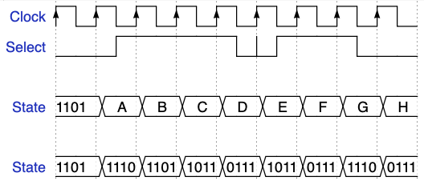
If (Select)
Q <= Q<<1;
else
Q <= Q>>1;
{signal: [
{name: "Clock", wave: "P........"},
{name: "Select", wave: "lnh.pnhpl" },
{},
{name: "State", wave: "=========", data:["1101","A","B","C","D","E","F","G","H"] },
{},
{name: "State", wave: "=========", data:["1101","1110","1101","1011","0111","1011","0111","1110","0111"] },
]}
Q0
0
1
D Q
Q3
Q2
Select
CLK
Q3
0
1
D Q
Q2
Q1
Select
CLK
Q2
0
1
D Q
Q1
Q0
Select
CLK
Q1
0
1
D Q
Q0
Q3
Select
CLK
Notes:
A. C

Slide 93
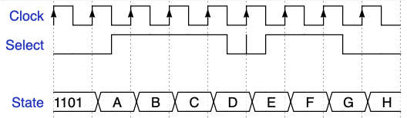
Q0
0
1
D Q
Q3
Q2
Select
CLK
Q3
0
1
D Q
Q2
Q1
Select
CLK
Q2
0
1
D Q
Q1
Q0
Select
CLK
Q1
0
1
D Q
Q0
Q3
Select
CLK
Notes:
A. C

Slide 94
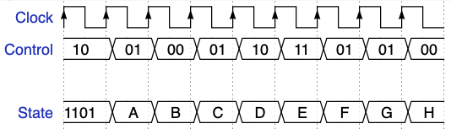
{signal: [
{name: "Clock", wave: "P........"},
{name: "Control", wave: "=========", data:["10","01","00","01","10","11","01","01","00"] },
{},
{name: "State", wave: "=========", data:["1101","A","B","C","D","E","F","G","H"] },
{},
{name: "State", wave: "=========", data:["1101","1010","1011","0000","0001","0010","0010","0011","0100"] },
]}
module unknown (
input wire logic [1:0] Control,
output logic[3:0] Q
always_ff @(posedge clk)
begin
if (Control == 2’b00)
Q <= 4’b0000;
else if (Control == 2’b01)
Q <= Q + 1;
else if (Control == 2’b10)
Q <= Q << 1;
end
endmodule

Slide 95
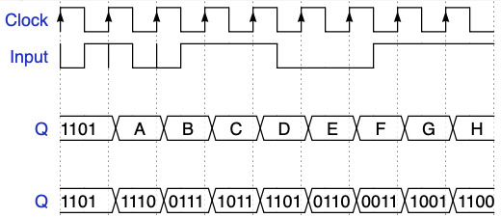
{signal: [
{name: "Clock", wave: "P........"},
{name: "Input", wave: "npnhplnh."},
{},
{name: "Q", wave: "=========", data:["1101","A","B","C","D","E","F","G","H"] },
{},
{name: "Q", wave: "=========", data:["1101","1110","0111","1011","1101","0110","0011","1001","1100"] },
]}
Q[3]
Q[2]
Q[1]
Q[0]
SerIn
D Q
D Q
D Q
D Q
CLK
CLK
CLK
CLK

Slide 96
A. assign Q = (A==B)? 1’b1:1’b0;
B. assign Q = ((A^B)==0)? 1’b1:1’b0;
C. assign Q = ((&(A^B))==0)? 1’b1:1’b0;
D. assign Q = ((A|B)==A)? 1’b1:1’b0;
E. assign Q = ((A&B)==A)? 1’b1:1’b0;
F. assign Q = ((|(A^B))==0)? 1’b1:1’b0;
G. assign Q = ((A&~B)==0)? 1’b1:1’b0;
H. assign Q = ((A|~B)==(~A|B))? 1’b1:1’b0;
A. assign Q = (A==B)? 1’b1:1’b0;
B. assign Q = ((A^B)!=0)? 1’b1:1’b0;
C. assign Q = ((&(A^B))==0)? 1’b1:1’b0;
D. assign Q = ((A|B)==A)? 1’b1:1’b0;
E. assign Q = ((A&B)==B)? 1’b1:1’b0;
F. assign Q = ((|(A^B))==0)? 1’b1:1’b0;
G. assign Q = ((A&~B)==0)? 1’b1:1’b0;
H. assign Q = ((A|~B)==(~A|B))? 1’b1:1’b0;
A. A==B
B. (A^B)=0 when all four pairs are the same
C. A=0101 B=0111 A^B=0010 &(A^B) = 0. different but still 0
D. A=0101 B=0000 A|B=A
E. A=0101 B=1111 A&B=A
F. |(A^B))=0 when all four pairs are the same
G. A=0101 B=1111 A&~B=0
H. A+B’=B+B’=1=A’+B=B’+B
Which statements assign 1 to Q if A=4’b1010 and B=4’b0000

Slide 97
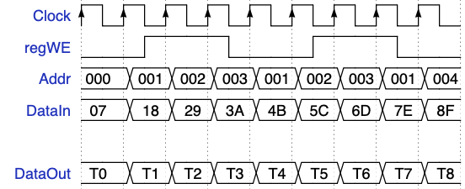
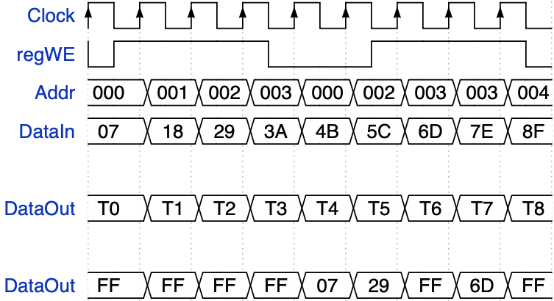
{signal: [
{name: "Clock", wave: "P........"},
{name: "regWE", wave: "lnhplnhpl"},
{name: "Addr", wave: "=========", data:["000","001","002","003","001","002","003","001","004"] },
{name: "DataIn", wave: "=========", data:["07","18","29","3A","4B","5C","6D","7E","8F"] },
{},
{name: "DataOut", wave: "=========", data:["T0","T1","T2","T3","T4","T5","T6","T7","T8"] },
{},
{name: "DataOut", wave: "=========", data:["00","00","00","00","18","29","00","18","00"] },
]}

Slide 98
module regFile (
input wire logic clk, regWE,
input wire logic[2:0] Addr,
input wire logic[7:0] DataIn,
output logic[7:0] DataOut
);
logic[7:0] Reg0,Reg1,Reg2,Reg3, Reg4,Reg5,Reg6,Reg7;
always_ff @(posedge clk)
if (regWE)
case(Addr)
3’b000: Reg0 <= DataIn;
3’b001: Reg1 <= DataIn;
3’b010: Reg2 <= DataIn;
3’b011: Reg3 <= DataIn;
3’b100: Reg4 <= DataIn;
3’b101: Reg5 <= DataIn;
3’b110: Reg6 <= DataIn;
default: Reg7 <= DataIn;
endcase
assign DataOut = (Addr == 3’b000)? DataOut = Reg0 : (Addr == 3’b001)? DataOut = Reg1 :
(Addr == 3’b010)? DataOut = Reg2 :
(Addr == 3’b011)? DataOut = Reg3 :
(Addr == 3’b100)? DataOut = Reg4 :
(Addr == 3’b101)? DataOut = Reg5 :
(Addr == 3’b110)? DataOut = Reg6 :
Reg7;
endmodule
Write
Decoder
Reg0
n
Reg1
n
Reg2
n
Reg3
n
Register write signals
8:1 MUX
DataOut
Reg4
n
n=16
Reg5
n
Reg6
n
Reg7
n
m=3
n=16
regWE
DataIn
clk
Addr

Slide 99
Yet Another Counter
module upCnt #(WID=4)(
input logic clk, clr, inc,
output logic[WID-1:0] q
);
always_ff @(posedge clk)
if (load)
q <= d;
else if (?)
q <= q + 1;
endmodule
+1
0
1
0
1
D Q
q
d
4
4
inc
load
clk
!load
load
!inc
inc
q <= 0;
q <= d;
q <= q + 1;
q <= q;

Slide 100
A Swapper
module unknown (
input logic a,
output logic[3:0] d
);
assign d = (4'b1000 >> b);
endmodule
module swapper (
input logic clk, load, swap, a, b,
output logic out1, out2
);
always_ff @(posedge clk)
if (?)
begin
out1 <= a;
out2 <= b;
end
else if (?)
begin
out1 <= out2;
out2 <= out1;
end
endmodule
0
1
D Q
0
1
a
out1
swap
load
clk
!load
load
!swap
swap
0
1
D Q
0
1
b
out2
swap
load
clk

Slide 101
A Swapper
module swapper (
input logic clk, load, swap, a, b,
output logic out1, out2
);
always_ff @(posedge clk)
if (load)
begin
out1 <= a;
out2 <= b;
end
else if (swap)
begin
out1 <= out2;
out2 <= out1;
end
endmodule
0
1
D Q
0
1
a
out1
swap
load
clk
0
1
D Q
0
1
b
out2
swap
load
clk

Slide 102
A Shift Register
Q[3]
Q[2]
Q[1]
Q[0]
module delay4 (
input logic clk, SerIn,
output logic[3:0] Q
);
always_ff @(posedge clk)
Q <= ？;
endmodule
SerIn
D Q
D Q
D Q
D Q
CLK
CLK
CLK
CLK
{SerIn, Q[2:0]}
{Q[3:1], SerIn}
{SerIn, Q[3:1]}
{Q[2:0], SerIn}
{Q[2:1], SerIn}
Notes:
C

Slide 103
A Shift Register
module delay4 (
input logic clk, SerIn,
output logic[3:0] Q
);
always_ff @(posedge clk)
Q <= {SerIn, Q[3:1]};
endmodule
Q[3]
Q[2]
Q[1]
Q[0]
SerIn
D Q
D Q
D Q
D Q
CLK
CLK
CLK
CLK

Slide 104
Another Shift Register
module delay3 (
input logic clk, SerIn,
output logic Q
);
logic a, b;
always_ff @(posedge clk)
begin
a <= SerIn;
b <= a;
Q <= b;
end
endmodule
SerIn
D Q
a
D Q
b
D Q
Q
CLK
CLK
CLK

Slide 105
Yet Another Shift Register
module delay3 (
input logic clk, SerIn,
output logic Q
);
logic a, b;
always_ff @(posedge clk)
begin
Q <= b;
b <= a;
a <= SerIn;
end
endmodule
SerIn
D Q
a
D Q
b
D Q
Q
CLK
CLK
CLK
Order of assignments DOES NOT MATTER…

Slide 106
A Shift Register
Q[3]
Q[2]
Q[1]
Q[0]
module delay4 (
input logic clk, SerIn,
output logic[3:0] Q
);
always_ff @(posedge clk)
？
endmodule
SerIn
D Q
D Q
D Q
D Q
CLK
CLK
CLK
CLK
Q<={SerIn, Q[2:0];
Q<={Q[3:1], SerIn}
Q<={SerIn, Q[3:1]}
Q<={Q[2:0], SerIn}
Q<={Q[2:1], SerIn}
Q<={Q, SerIn}
Notes:
C

Slide 107
A Shift Register
Q[0]
Q[1]
Q[2]
Q[3]
module delay4 (
input logic clk, SerIn,
output logic[3:0] Q
);
always_ff @(posedge clk)
？
endmodule
SerIn
D Q
D Q
D Q
D Q
CLK
CLK
CLK
CLK
Q<={SerIn, Q[2:0];
Q<={Q[3:1], SerIn};
Q<={SerIn, Q[3:1]}
Q<={Q[2:0], SerIn};
Q<={Q[2:1], SerIn};
Q<={Q, SerIn};
always_comb
begin
C = A & B;
D = C | B;
end
Notes:
D

Slide 108
module problem(A, B, Q);
input wire logic [3:0] A, B;
output logic [1:0] Q;
assign Q[1] = &(~A&B|A&~B);
assign Q[0] = ((A|B)==1 && (B&4’b0011)==0) ? 1’b1:1’b0;
endmodule

Slide 109
module unknown (
input wire logic [1:0] b,
output logic[3:0] d
);
assign d = 4'b1000 >> b;
endmodule
module myram(
input logic clk, we,
input logic[9:0] addr,
input logic[15:0] di,
output logic[15:0] dout
);
logic[15:0] ram [1024];
always_ff @(posedge clk)
begin
if (we) begin
ram[addr] <= di;
dout <= di;
end
else
dout <= ram[addr];
end
endmodule
module multiAssign (
input logic clk, clear,
output logic[3:0] Q
);
always_ff @(posedge clk)
begin
Q <= 4'b0000;
if (!clear)
Q <= Q + 1;
end
endmodule
always_ff @(posedge clk)
Q <= {1’b0, Q[3:1]};
always_ff @(posedge clk)
Q <= {Q[2:0], 1’b0};

Slide 110
always_ff @(posedge clk)
begin
if (control == 2’b00)
Q <= 4’b0000;
else if (control == 2’b01)
Q <= Q + 1;
else if (control == 2’b10)
Q <= Q << 1;
end
Always_ff @(posedge clk)
if (clr)
q <= 0;
else if (inc)
q <= q + 1;
Always_ff @(posedge clk)
if (inc)
q <= q + 1;
else if (clr)
q <= 0;
module problem(a, b, q);
input[3:0] a, b;
output[1:0] q;
assign q[1] = &({2{2'b01}}|(a^b));
assign q[0] = (b<(a>>1))?1'b0:1'b1;
endmodule
always_ff @(posedge clk)
begin
a <= b;
b <= a;
end

Slide 111
module unknown(reset, clk, ctrl, zeronumber, cs);
input logic reset, clk;
input logoc [1:0] ctrl;
input logic [15:0] zeronumber;
output logic reg [15:0] cs;
logic [15:0] ns;
myReg R0 (clk, ns, cs); -- Flip flops
assign ns = (ctrl == 2'b00)? 16’b0000000000000000:
(ctrl == 2‘b01)? {1’b0, cs[15:1]}：
(ctrl == 2'b10）? cs:
{cs[14:0], 1'b0};
endmodule
always_ff @(posedge Clock)
begin
C <= A & B;
D <= C | B;
end
always_comb
begin
C = A & B;
D = C | B;
end

Slide 112
module Unknown (
input logic clk, A,
output logic[3:0] B
);
always_ff @(posedge clk)
if (A)
B <= 0;
else
B <= B + 1;
endmodule
module dff (
input logic Clock, D,
output logic Q
);
always_ff @(posedge Clock)
Q <= D;
endmodule
always_ff @(posedge clk)
if (load) a <= 4’b1000;
else begin
a <= a >> 1;
b <= a + 1;
c <= ~b;
end
always @(posedge clk)
if (inc)
q <= q + 1;
else if (clr)
q <= 0;

Slide 113
Q’
Q’
Q
CLK
Q
Q
CLK
Q
CLK
D
D
D
Q’
CLK
CLK
Suppose the flip flop in the circuit below has a setup time of 3 ns, a hold time of 1 ns, and a clock- to-Q time of 5 ns. What is the longest allowable delay of the inverter in the circuit that will allow for a clock rate of 100 MHz? 2 ns
Suppose the flip flop in the circuit below has a setup time of 6 ns, a hold time of 0.5 ns, and a clock- to-Q time of 9 ns and the AND gate causes a delay of 2 ns. What is the longest allowable delay of the OR gate in the circuit that will allow for a clock rate of 50 MHz? 3 ns
In the previous problem if the inverter has a 4.5 ns delay time, what is the maximum frequency this circuit can be clocked at?
80 MHz
In the previous problem if the OR gate has a 5 ns delay time, what is the maximum frequency this circuit can be clocked at?
45.45 MHz
In the previous problem if the initial state is Q = 0, what is its next state value?
1

Slide 115
JAN
carol
OFL
MARCIA
mike
State
alice
IFL
FFs
GREG
Clk
A
alice’
alice/JAN
mike’•carol’
B
carol/MARCIA
mike/GREG
C
D
GREG

Slide 116
module sequence(
input logic wire clk, Xin,
output logic Z
);
typedef enum {S0, S1, S2, S3} StateType;
StateType next_state, current_state;
always_comb
begin
next_state = current_state;
Z = 1’b0;
if (reset)
ns = s0;
else
case (current_state)
S0: if (Xin == 1’b0) next_state = S1;
else next_state = S0;
S1: if (Xin == 1’b1) next_state = S2;
else next_state = S1;
S2: if (Xin == 1’b1) next_state = S3;
else next_state = S1;
S3: begin
Z = 1’b1;
if (Xin == 1’b0) next_state = S1;
else next_state = S0;
end
endcase
end
always_ff@(posedge clk)
current_state <= next_state;
endmodule

Slide 117
CLK
Xin
a.
b.
c.
d.
e.
f.
g.
h.
S0
S0
S1
S2
S3
S1
S2
S0
S0
S1
S1
S2
S2
S3
c
S0
S0
S1
S1
S2
S3
S1
S0
S1
S2
S3
S1
S2
S3
S0
S1
S1
S2
S2
S3
S3
S0
S0
S2
S1
S3
S2
S3
S0
S0
S1
S2
S2
S3
S3
S0
S0
S1
S2
S2
S2
S3

Slide 118
current
_state
S0
S0
S1
S1
S2
S3
S1
a.
b.
c.
d.
e.
f.
g.
Z
d

Slide 119
Old Exams

Slide 120
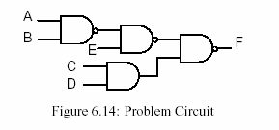
A
B
F
C
D

Slide 121
a.
b.
c.
d.
e.
f.
a.
b.
c.
d.
e.
f.

Slide 122
Clock
D
module dff (
input wire logic clk, D,
output logic Q
);
always_ff @(negedge clk)
Q <= D;
endmodule
a.
b.
c.
d.
e.
f.
D Q
module dff (
input logic clk, D,
output logic Q
);
always_ff @(posedge clk)
Q <= D;
endmodule
D Q
d
b
CLK
CLK

Slide 123
M | N | P₀ | F
0 | 0 | 0 | 1
0 | 0 | 1 | x
0 | 1 | 0 | 1
0 | 1 | 1 | 1
1 | 0 | 0 | 0
1 | 0 | 1 | 0
1 | 1 | 0 | x
1 | 1 | 1 | x
A
B
C
F
A
B
F
C
A
B
C
Q’
Q’
Q
Q
Q’
Q’
Q
Q
Q’
Q’
Q
Q
CLK
CLK
CLK
CLK
CLK
D
CLK
D
D
D
D
D
CLK
A’ C

Slide 124
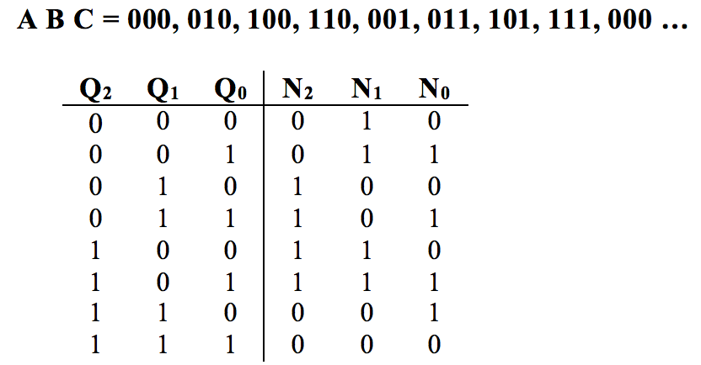
      Design a counter which counts in the following sequence:
A B C = 000, 010, 100, 110, 001, 011, 101, 111, 000 …
Implement the counter with D flip-flops. What is the next state equation for N_{A} ?
Give your answer in minimum sum of products form.
a. N_{C} = B’C + A’C e. N_{C} = A’B’+B’C+BC’
b. N_{C} = A’B’ + B’C + ABC’ f. N_{C} = B’
c. N_{C} = A’B + AB’ g. N_{C} = AC + B’C + A’C’
d. N_{C} = AB + A’C h. N_{C} = B’C+A’C+ABC’
A B C = 000, 001, 100, 010, 101, 110, 000 …
NA = A’B+C
NB = AB’
NC = A’C’
NA=A’B+AB’
NB=B’
NC=B’C+A’C+ABC’
A B C = 001, 011, 010, 110, 111,101, 100, 001 …
NA=AC+BC’
NB=A’+BC’
NC=AB+B’C’+A’B’

Slide 125
A
0 | 0 | 0 | 0 | x | x | x | x
0 | 0 | 0 | 1 | x | x | x | x
0 | 0 | 1 | 0 | 1 | 1 | 1 | 0
0 | 0 | 1 | 1 | 0 | 1 | 1 | 0
0 | 1 | 0 | 0 | x | x | x | x
0 | 1 | 0 | 1 | 1 | 1 | 0 | 1
0 | 1 | 1 | 0 | 0 | 0 | 1 | 0
0 | 1 | 1 | 1 | 1 | 0 | 1 | 1
1 | 0 | 0 | 0 | x | x | x | x
1 | 0 | 0 | 1 | x | x | x | x
1 | 0 | 1 | 0 | x | x | x | x
1 | 0 | 1 | 1 | 0 | 0 | 1 | 1
1 | 1 | 0 | 0 | x | x | x | x
1 | 1 | 0 | 1 | 0 | 1 | 1 | 1
1 | 1 | 1 | 0 | 0 | 1 | 0 | 1
1 | 1 | 1 | 1 | x | x | x | x
B
C
D
NA=A’BD+B’D’
NB=AB + C’ + A’B’
NC=A’C+AD
ND=A+BD

Slide 126
A
0 | 0 | 0 | 0 | x | x | x | x
0 | 0 | 0 | 1 | 0 | 0 | 1 | 0
0 | 0 | 1 | 0 | 1 | 0 | 1 | 0
0 | 0 | 1 | 1 | x | x | x | x
0 | 1 | 0 | 0 | x | x | x | x
0 | 1 | 0 | 1 | 0 | 0 | 0 | 1
0 | 1 | 1 | 0 | x | x | x | x
0 | 1 | 1 | 1 | x | x | x | x
1 | 0 | 0 | 0 | x | x | x | x
1 | 0 | 0 | 1 | x | x | x | x
1 | 0 | 1 | 0 | 1 | 0 | 1 | 1
1 | 0 | 1 | 1 | 1 | 1 | 0 | 0
1 | 1 | 0 | 0 | 0 | 1 | 0 | 1
1 | 1 | 0 | 1 | x | x | x | x
1 | 1 | 1 | 0 | x | x | x | x
1 | 1 | 1 | 1 | x | x | x | x
B
C
D
0010-1010-1011-1100-0101-0001-0010….
x | x | 0 | x
0 | 0 | x | x
x | x | x | 1
1 | x | x | 1
x | x | 1 | x
0 | 0 | x | x
x | x | x | 1
0 | x | x | 0
NA=C
AB’+C
N_{D} = A'C + AC' + C'D e. N_{D} = AC' + A'C + D'
b. N_{D} = A'C + AB + AD f. N_{D} = A + BD
c. N_{D} = AC + BD g. N_{D} = AC' + B' + CD
d. N_{D} = A + C' + BD h. N_{D} = B'C' + A'D + CD
x | x | 0 | x
1 | 0 | x | x
x | x | x | 0
1 | x | x | 1
x | x | 1 | x
0 | 1 | x | x
x | x | x | 0
0 | x | x | 1

Slide 127
CLK
A
B
Q’
Q’
Q
Q
Q’
Q’
Q
Q
CLK
CLK
CLK
D
CLK
D
D
D
A’ B
A’ B
Na = A’B
Nb = A’+B
A | B | NA | NB
0 | 0 | 0 | 1
0 | 1 | 1 | 1
1 | 0 | 0 | 0
1 | 1 | 0 | 1
What state follows
A B = 0 1?

Slide 128
CLK
A
B
C
Q’
Q’
Q
Q
Q’
Q’
Q
Q
Q’
Q’
Q
Q
CLK
CLK
CLK
CLK
CLK
D
CLK
D
D
D
D
D
A’ B
C+ = A’+B ABC=000 – 111 - 001
B+ = A’C’ - 101 – 100 – 100 …
A+ = B’

Slide 129
Clock-to-Q Time (t_{CLK➔ Q})
D
Q
Q’
t_{NOT} = 1 ns
t_{AND} = 2 ns
t_{NOR} = 3 ns
CLK
t_{CLK ➔ Q} = t_{NOT} + t_{AND} + 2 x t_{NOR}
= 1 + 2 + 2 x 3
= 9
The output does not change instantaneously…

Slide 130
Setup Time (t_{setup})
D
Q
Q’
CLK
t_{setup} = t_{NOT} + t_{AND} + 2 x t_{NOR}
= 1 + 2 + 2 x 3 = 9
t_{NOT} = 1 ns
t_{AND} = 2 ns
t_{NOR} = 3 ns
The input has to get there early enough
to set the master latch before
the clock turns off…

Slide 131
Falling Edge Hold Time (t_{hold})
D
Q
Q’
CLK
t_{hold} = 0ns (AND gates turn off immediately)
You have to keep the old D value there until the AND
gates are shut off… (but no longer)

Slide 132
Rising Edge Hold Time (t_{hold})
D
Q
Q’
t_{hold} = t_{NOT}
CLK
You have to keep the old D value there until the AND
gates are shut off…

Slide 133
INC | Q1 | Q0 | N1 | N0 | Z | Y
0 | 0 | 0 | 0 | 0 | 0 | 0
0 | 0 | 1 | 0 | 1 | 0 | 0
0 | 1 | 0 | 1 | 0 | 0 | 0
0 | 1 | 1 | 1 | 1 | 1 | 0
1 | 0 | 0 | 0 | 1 | 0 | 0
1 | 0 | 1 | 1 | 0 | 0 | 0
1 | 1 | 0 | 1 | 1 | 0 | 0
1 | 1 | 1 | 0 | 0 | 1 | 1
What is the equation for output Z?
What is the equation for output Y?
Z = Q1Q2 Moore
Y = IncQ1Q2 Mealy
      Consider the circuit from the previous problem. When Q₁Q₀ is in State 10 and Inc is 0, what are outputs Y and Z and what is the next state N₁N₀ right before the next clock arrives?
Y=0, Z=0, N₁N₀=10

Slide 134
F=Σm(3, 7, 8, 9, 11, 12, 13, 15)
What is the expression for this function in minimum SOP form using hazard free design techniques?
F = CD + AC’ + AD

Slide 135
module unknown(o, c, a, b);
input c, a, b;
output o;
wire cnot, a1, a2;
not(cnot, c);
and(a1, cnot, a);
and(a2, c, b);
or(o, a1, a2);
endmodule
What is this module? The first parameter (signal) of these built-in gates is for the output signal. 2:1 MUX

Slide 136
What is the binary value of this number in Verilog?
4’d8
1000
0100
1100
00000100
00001111
01001000
assign q = (~sel & a) | (sel & b);
2:1 MUX
assign n = 4’b0100 >> 4’b0001
What is n? 0010
assign m = 2{4’b0101} what is m? 8’b01010101
assign n = &2{4’b0101} what is n? 1’b0
a=0011 and b=1100
assign m = {a, b} what is m? 00111100

Slide 137
q
0
1
0
1
D Q
q
q >> 1
q << 1
4
4
S1
clk
S0
b
a. | always_ff @(posedge clk) if (S0) q <= q >> 1; else if (S1) q <= q << 1; | b. | always_ff @(posedge clk) if (S0) q <= q << 1; else if (S1) q <= q >> 1; | c. | always_ff @(posedge clk) if (S1) q <= q << 1; else if (S0) q <= q >> 1;
d. | always_ff @(posedge clk) if (S1) q <= q >> 1; else if (S0) q <= q << 1; | e. | always_ff @(posedge clk) if (!S0 && S1) q <= q >> 1; else q <= q << 1; | f. | always_ff @(posedge clk) if (S0 && !S1) q <= q >> 1; else q <= q << 1;

Slide 138
Xin’
module fsm (clk, reset, Xin, Z);
input clk, reset, Xin;
output Z;
reg[1:0] state;
parameter s0 = 2'b00;
parameter s1 = 2'b01;
parameter s2 = 2'b10;
parameter s3 = 2'b11;
always_ff @(posedge clk)
begin
if (reset)
state <= ?;
else
case (state)
s0: if (Xin) state <= s1;
s1: if (Xin) state <= s2;
s2: if (??) state <= s1;
else state <= s3;
endcase
end
// The output forming logic
assign Z = state==s3 ? 1'b1 : 1'b0;
endmodule
reset
S0
Xin
S3
S1
Z
Xin’
Xin
Xin’
S2
Xin

Slide 139
x
x
00
00
x
x’
x
x’
11
x’
01
11
Z
x’
01
x’
x’
x’
x’
x
x
x / Y
x
10
10
D₀ = X’ + Q₁Q₀’
Y = XQ₁Q₀’
D₁ = XQ₁Q₀’+ XQ₁’Q₀
Z=Q₁Q₀
Retake

Slide 140
Modified in November, 2016
x
x
00
00
x / Y
x’
x
x’
01
x’
11
01
Z
x’
11
x’
x’
x’
x’
x
x
x
x
10
10
D₁ = X’ + Q₁Q₀
D₀ = X’ + Q₁Q₀’
Y = XQ₁’Q₀
Z=Q₁Q₀
Retake

Slide 141
Modified in March, 2017
00
x
x’
Y
01
x’ / Y
11
x / Y
x’
x’
x
10
x
D₁ = X’ + Q₁
D₀ = X’ + Q₁’
Y = Q₀

Slide 142
Y=Q1’Q0
D1=Inc’Q1+Q1Q0’+IncQ1’Q0
D0=Inc’Q0+IncQ0’
Practice Question
Y=Q1’Q0’, Q1Q0’, Q1Q0
D1= IncQ1+Inc’Q0, Inc’Q1+IncQ0’, IncQ1Q0+Inc’Q1’Q0’
D0=IncQ1+IncQ0, IncQ1’+IncQ0’, IncQ1+Inc’Q0’
INC’
00
INC
INC
11
Y
01
INC’
INC’
INC
INC
10
INC’

Slide 143

A
w’x’
D
w
(w+x)’
w
wx
x
C
(wx)’
w’z’
x+y
w’z’
B
x’y’
E
D is complete but has a conflict
F has no conflict but is not complete
wz
A and D have a conflict and C and E are incomplete
A
w’x’
B
w
w
wx
x
C
w’z’
(wx)’
x+y
w’z’
C is complete but has a conflict
E has no conflict but is not complete
D
x’y’
E
wz
A is incomplete and has a conflict, B is complete but has a conflict C is incomplete but no conflict, D is good, E is incomplete

Slide 144
CLR’ • INC’
Practice Question
00
CLR’ • INC
CLR’ • INC
11
CLR
CLR
01
CLR’ • INC’
CLR’ • INC’
CLR
INC
CLR’ • INC
10
CLR’ • INC’
00 has no conflict but is not complete
10 is complete but has a conflict

Slide 145

0/1
01
1/1
1/0
1/1
Retake
00
10
0/0
0/0
1/1
11
0/0
N_{A} = AB + X’A’B’ + XB
N_{B} = A’+X’B+XB’
Z = A’B + XA’ + XB
N_{B} = A’ + X’B + XB’
Z = B
1/0
1001
1001
01
0/1
0/0
NA=X’B+XB’
NB=A’
Z=A’B’+AB
1/1
00
11
1/1
0/0
0/1
10
1/0

Slide 146
0/1
00
1/0
1/1
0/0
0/0
11
01
1/0
1/1
Practice Question
10
0/1
N_{A}⁼XB’ +X’B , XB+X’B’ , AB’+A’B , AB+A’B’, X’A+AB+XA’B, XA+A’B’+XB
N_{B}⁼XA’ +X’A , XA+X’A’ , XB’ +X’B , XB+X’B’, AB’+A’B , AB+A’B’
Z= B’ , B , A’B’, A’B, AB’, AB, AB+A’B’,

Slide 147

Next state for C
a. M’K’C + MK’ + MA d. M’K’A + B
b. M’C + K’C + MK’D + MA e. M’K’C + MK’D
c. MKC’ + MK’D + MA f. MK + (MK)’
LARRY =
a. D d. M’K’A+D
b. MC+KD e. D+MA
c. MK’D+KE+M’K’D f. LD+SE
Next state for D
a. M’K’C + MK’ + MA d. MKC+M’K’D
b. M’C + K’C + MK’D + MA e. M’K’C + MK’D
c. MKC’ + MK’D + MA f. MK + (MK)’
Retake
TIGER =
a. E d. M’K’ +D
b. MC+KD e. E+MB
c. B+ME f. LD+SE
For the state graph in Problem 7, use D-type flip flop and one-hot encoding. What is the simplified output equation for SAM ? E

Slide 148
x0000 | 1010001000000011 | R1 = mem[mem[PC+SEXT(3)] | R1 = 6
x0001 | 0001010001111110 | R2 = R1 - 2 | R2 = 4
x0002 | 0111001010000001 | mem[R1+SEXT(1)] = R2 | X0007 = 4
x0003 | 0000000000000100
x0004 | 0000000000000101
x0005 | 0000000000000110
x0006 | 0000000000000111
x0007 | 0000000000001000 | 4

Slide 149
LOCKED’
D
LOCKED/ CLRCNTR
PUSHED•9/ UNLOCK
PUSHED’
PUSHED’
A
B
C
PUSHED’
PUSHED•7
PUSHED•8
Start
PUSHED•7’/
INC
PUSHED•8’/
INC
WAITDONE/
CLRCNTR
PUSHED•9’/
INC
ECNT3’
F
E
ECNT3/ CLRTIMER
ERROR
WAITDONE’

Slide 150
NA = (PUSHED’•A) + (ECNT3’•E)
+ (WAITDONE•F)
+ (LOCKED•D)
NB = (PUSHED’•B)+(PUSHED•7•A)
NC = (PUSHED’•C)+(PUSHED•8•B)
ND = (LOCKED’•D)+(PUSHED•9•C)
NE = (PUSHED•7’•A)
+ (PUSHED•8’•B)
+ (PUSHED•9’•C)
NF = (ECNT3•E)
+ (WAITDONE’•F)
ERROR = E
INC = (PUSHED•7’•A)
+ (PUSHED•8’•B)
+ (PUSHED•9’•C)
CLRTIMER = ECNT3•E
CLRCNTR = (WAITDONE•F)
+ (LOCKED•D)
UNLOCK = (PUSHED•9•C)
For the state graph in the previous problem, the state encodings are as follows (NOT one-hot encoding):
A = 000, B = 001, C = 011, D = 010, E = 100, F= 101
Assume that Q₂ , Q₁ and Q₀ are the current state bits and that N₂ , N₁ and N₀ are the next state bits. Use D-type flip flops. What is the output equation for ERROR? Q₂Q₀’

Slide 151
N₀ = Q₂’ Q₀ + Q₁ + Q₁’Z e. N₀ = Q₂Y + Q₂Z + Q₂Q₁’
N₀ = Q₂’ + Q₁Y + Q₂Q₁’Z f. N₀ = Q₀’ + Q₀Y + Q₀Z
N₀ = Q₁Y + Q₀Z g. N₀ = Q₁Y + Q₂Q₁’Z
N₀ = Q₁Y + Q₂Z h. N₀ = Q₀Y + Q₁Y + Q₂Z + Q₃Z
N₁ = Q₀Y’Z’+ Q₂Y’Z’ e. N₁ = Q₂Y + Q₂Z + Q₂Q₁’
N₁ = Q₁Y’ f. N₁ = Q₀’ + Q₀Y + Q₀Z
N₁ = Q₀Y’Z + Q₃YZ’ g. N₁ = Q₁Y + Q₂Q₁’Z
N₁ = Q₁Y + Q₂Z h. N₁ = Q₀Y + Q₁Y + Q₂Z + Q₃Z
Retake

Slide 152
Practice Exam
The state graph below defines a state machine with four states and two inputs (x and y). The state of the four flip-flops for each state are shown on the state graph. That is, a state encoding of 0 0 0 1 means Q₃ = 0, Q₂ = 0, Q₁ = 0 and Q₀ = 1.
If this state machine is implemented with clocked D flip-flops, what is the next state equation for Flip-flop Q₁ (N₁)? Make sure the next state equations are in minimum sum of products form.
N0 = Q₀•x’+ Q₁•x’ + Q₃
N1 = Q₀•x
N2 = Q₁•x + Q₂•y’
N3 = Q₂•y
Z = Q₁Q₂
x’
0001
x’
x
1000
Z
0010
y
x
0100
Z
y’

Slide 154
a
0
1
0
1
f
f
a
s
s
a. b. c.
a
a
a
f
f
f
s
f
s
s
d. e. f.
a
a
f
f
s
s
a
s

Slide 155
a
0
1
f
b
c

Slide 156
15 | 20 | 30 | 35 | F
0 | 0 | 0 | 0 | 0
0 | 0 | 0 | 1 | 0
0 | 0 | 1 | 0 | 0
0 | 0 | 1 | 1 | 0
0 | 1 | 0 | 0 | 0
0 | 1 | 0 | 1 | 0
0 | 1 | 1 | 0 | 0
0 | 1 | 1 | 1 | 1
1 | 0 | 0 | 0 | 0
1 | 0 | 0 | 1 | 0
1 | 0 | 1 | 0 | 0
1 | 0 | 1 | 1 | 1
1 | 1 | 0 | 0 | 0
1 | 1 | 0 | 1 | 1
1 | 1 | 1 | 0 | 0
1 | 1 | 1 | 1 | 1
 | 00 | 01 | 11 | 10
00 | 0 | 0 | 0 | 0
01 | 0 | 0 | 1 | 0
11 | 0 | 1 | 1 | 1
10 | 0 | 0 | 0 | 0
AB
CD
I₀
I₁
I₂
I₃
I₄
I₅
I₆
I₇
A C D
 | 00 | 01 | 11 | 10
00 | 0 | 0 | 0 | 1
01 | 0 | 1 | 1 | 1
11 | 0 | 1 | 1 | 0
10 | 1 | 1 | 1 | 1
AB
CD
 | 00 | 01 | 11 | 10
00 | 1 | 1 | 0 | 1
01 | 0 | 1 | 0 | 1
11 | 0 | 1 | 1 | 1
10 | 1 | 1 | 1 | 1
AB
CD

Slide 157

+1
0
1
0
1
D Q
Q<<1
4
4
4
4
0000
Q_{A}
clock
Q_{D}

